Slide 1
Recommender systems

Slide 2
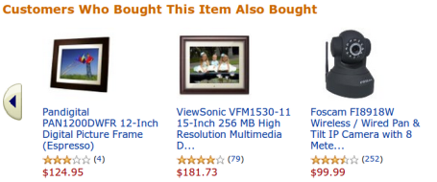



Application Areas
Products
People
News
People
Notes:
Recommender systems are widely used by many websites and applications to provide value for the user and the provider.
For users recommender systems help, e.g. in the context of a product search,
– find things that are interesting
– narrow down the set of choices
– help explore the space of options
– Discover new things
For providers recommender systems help to
– increase trust and customer loyalty with personalized services
– increase sales, click rates, page views etc.
– identify opportunities for promotion and persuasion
– obtain more knowledge about customers

Slide 3




Definition: Recommender System
Given a user model and a set of items, a recommender system is a function that helps to match users with items by ranking the items in order of decreased relevance
Learning a ranking function
Notes:
A recommender systems identifies for a given user a set of items that are relevant to her. This can result in a ranking of the items (modelling a relevance function) or a classification.
The user model typically includes data such as ratings, preferences, demographics and attributes that characterize the user The items can also be enriched with attributes about their content and characteristics, although it is not always necessary.

Slide 4



Collaborative Recommender System
Collaborative = “Tell me what other people like”
User profile
+
Context information
RS
Recommendation
list
Community data
(Ratings)
Collaborative Filtering
Notes:
In the collaborative paradigm, the recommender system uses the user profile (and possibly other information about the specific context in which the user needs a recommendation) and the data provided by other users to return a recommendation list with the most relevant items and their scores, from the highest (i.e., most relevant) to the lowest (i.e., least relevant). It is called collaborative because all the user participates to the recommendation by providing ratings to the items that they viewed/purchased etc.

Slide 5



Content-based Recommender System
Content-based = “Show me more of what I liked”
User profile
+
Context information
RS
Recommendation
list
Item profile
+
Past ratings
Notes:
In the content-based paradigm, the recommender system uses the profile of the items that the user rated in the past to return a recommendation list with the most relevant items and their scores, from the highest (i.e., most relevant) to the lowest (i.e., least relevant). It is called content-based because the items are not only objects, but they are defined by a set of attributes that summarize the content of the item.
There are also other approaches, such as hybrid ones, which combine collaborative and content-based, or knowledge-based ones, which require domain knowledge engineering to model how certain item features meet the user needs.

Slide 6
Collaborative Filtering
A widely used approach to generate recommendations
Used by large e-commerce sites
Applicable in many domains (e.g., books, movies ...)
Well understood and studied
Approach (Wisdom of the crowd)
Users give ratings to items
Users with similar tastes in the past will have similar tastes in the future
Notes:
Collaborative recommender systems are based on collaborative filtering. In collaborative filtering, given a user and an item not yet rated by the user, the goal is to estimate the user rating for this item by looking at the ratings for the same item that were given in the past by similar users. Collaborative filtering requires a community of users that provide ratings and a way to assess user similarity.

Slide 7
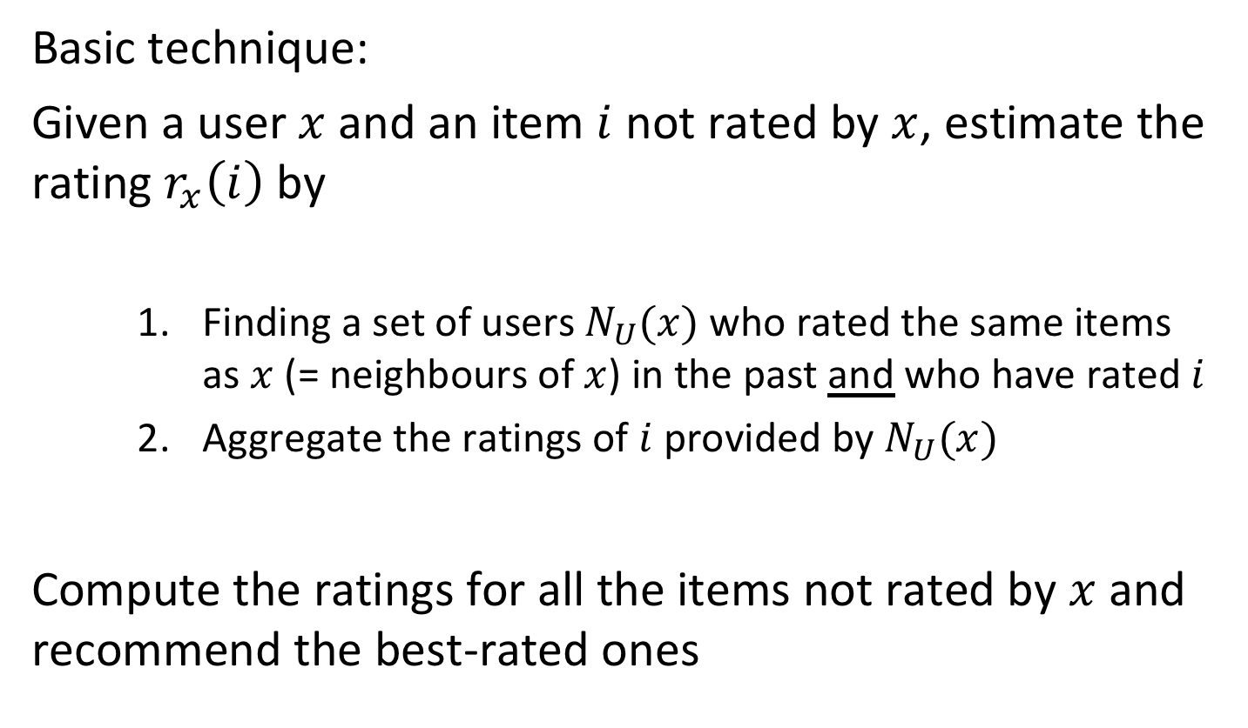
User-based Collaborative Filtering
Basic technique:
Given a user $x$ and an item $i$ not rated by $x$, estimate the rating $r_{x}\left(i\right)$ by
Finding a set of users $N_{U}(x)$ who rated the same items as $x$ (= neighbours of $x$) in the past and who have rated $i$
Aggregate the ratings of $i$ provided by $N_{U}(x)$
Compute the ratings for all the items not rated by $x$ and recommend the best-rated ones
Notes:
The basic technique for user-based collaborative filtering needs to define
A metric to compute similarity between users
The number of neighbours considered for $N_{U}(x)$
A way to aggregate the ratings of I provided by $N_{U}(x)$

Slide 8
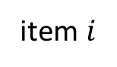
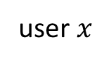
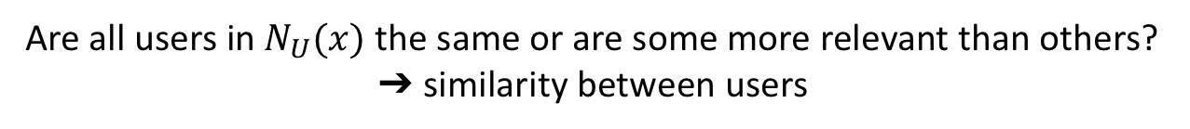
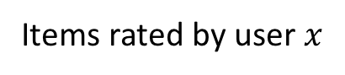
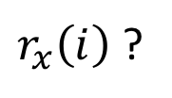
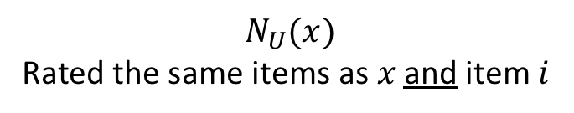
User-based Collaborative Filtering illustrated
user $x$
item $i$
$r_{x}\left(i\right)$ ?
Aggregate their ratings
Items rated by user $x$
$$N_{U}(x)$$
Rated the same items as $x$ and item $i$
Are all users in $N_{U}(x)$ the same or are some more relevant than others?
➔ similarity between users

Slide 9
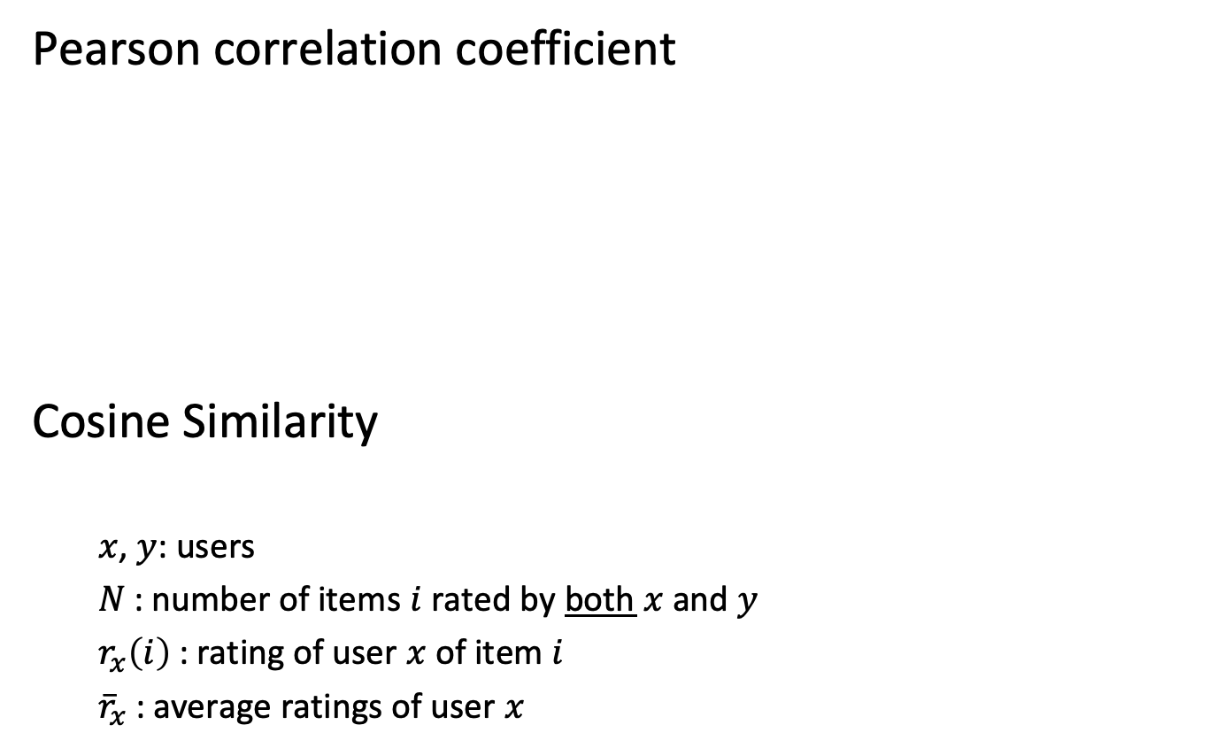
Similarity Between Users
Pearson correlation coefficient
Cosine Similarity
$x$, $y$: users
$N$ : number of items $i$ rated by both $x$ and $y$
$r_{x}\left(i\right)$: rating of user $x$ of item $i$
${\overline{r}}_{x}$: average ratings of user $x$
Notes:
A widely used similarity measure is the Pearson correlation coefficient, which returns a value between -1 and 1. The cosine similarity considers the users x and y as two N-dimensional vectors. Computing similarity follows exactly the same principles as for document similarity in vector space retrieval. If the angle between the two vectors is 0, thus the users are identical, and the cosine similarity returns 1. The greater the angle, the less similar the two users are. Assuming that all ratings are positive, the maximum angle is π/2, thus the minimum similarity is cos(π/2)=0.

Slide 10
Example
sim_{corr}(U, User1) = 0.85 sim_{cos}(U, User1) = 0.97
sim_{corr} (U, User2) = 0.71 sim_{cos}(U, User2) = 0.99
sim_{corr} (U, User3) = 0 sim_{cos}(U, User3) = 0.89
sim_{corr} (U, User4) = -0.79 sim_{cos} (U, User4) = 0.79
 | Item 1 | Item 2 | Item 3 | Item 4 | Item 5
U | 5 | 3 | 4 | 4 | ???
User 1 | 3 | 1 | 2 | 3 | 3
User 2 | 4 | 3 | 4 | 3 | 5
User 3 | 3 | 3 | 1 | 5 | 4
User 4 | 1 | 5 | 5 | 2 | 1
Notes:
This is an example of similarity computed using the two metrics. It is possible to see how the users are not ranked in the same way. For example, the most similar user to user U is User 1, if the Pearson correlation coefficient is used, or User 2, if the cosine similarity is used. Also User 4 is not that different from U using the cosine similarity, although he seems to have quite opposite tastes.
One drawback of Pearson correlation coefficient is that it is not computable, if the variance of one of the user ratings is 0 (e.g., a user with ratings 1 1 1 1). However, in general, the correlation coefficient works well in general domains.

Slide 11
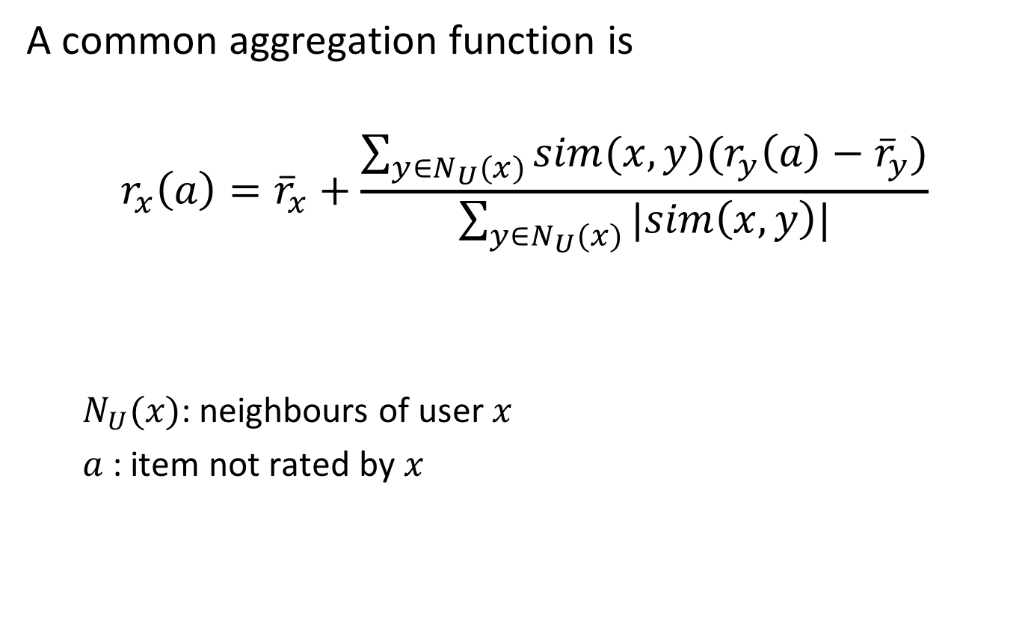
Aggregate the Ratings
A common aggregation function is
$$r_{x}\left(a\right)={\overline{r}}_{x}+\frac{\sum_{y∈N_{U}(x)}{sim(x,y)(r_{y}\left(a\right)−{\overline{r}}_{y})}}{\sum_{y∈N_{U}(x)}{|sim\left(x,y\right)|}}$$
$N_{U}(x)$: neighbours of user $x$
$a$: item not rated by $x$
Notes:
The aggregation function calculates whether the neighbours' ratings for the unseen item a are higher or lower than their average. We can consider this term as the bias of the user y w.r.t. item a. Then the function combines the rating bias using the similarity as a weight, so that the most similar neighbours will have more importance. Then the aggregated neighbours' bias is added/subtracted from user’s x average rating.

Slide 12
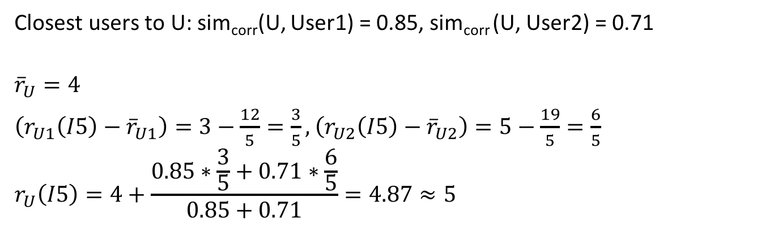
Example
 | Item 1 | Item 2 | Item 3 | Item 4 | Item 5
U | 5 | 3 | 4 | 4 | ???
User 1 | 3 | 1 | 2 | 3 | 3
User 2 | 4 | 3 | 4 | 3 | 5
User 3 | 3 | 3 | 1 | 5 | 4
User 4 | 1 | 5 | 5 | 2 | 1
Closest users to U: sim_{corr}(U, User1) = 0.85, sim_{corr} (U, User2) = 0.71
$${\overline{r}}_{U}=4$$
$\left(r_{U1}\left(I5\right)−{\overline{r}}_{U1}\right)=3−\frac{12}{5}=\frac{3}{5},$ $\left(r_{U2}\left(I5\right)−{\overline{r}}_{U2}\right)=5−\frac{19}{5}=\frac{6}{5}$
$$r_{U}\left(I5\right)=4+\frac{0.85∗\frac{3}{5}+0.71∗\frac{6}{5}}{0.85+0.71}=4.87≈5$$

Slide 13
User-based Collaborative Filtering
Problems
Cold start: users or items without ratings
Scalability: large numbers of users
Data dispersion: highly variable ratings, difficult to find similar users
Possible solution
Item-based collaborative filtering
Notes:
A typical problem of user-based collaborative filtering is the cold-start problem, that is, the recommendation for a new user that did not rate anything yet or for an item that was never rated. Also, user-based collaborative filtering is problematic when there are millions of users and/or items (Amazon, Netflix). For example, for each user the most similar users have to be found (nearest neighbours) from a large set of users. With large numbers of users, it becomes hard to find common ratings between users, due to the high dispersion of data.

Slide 14
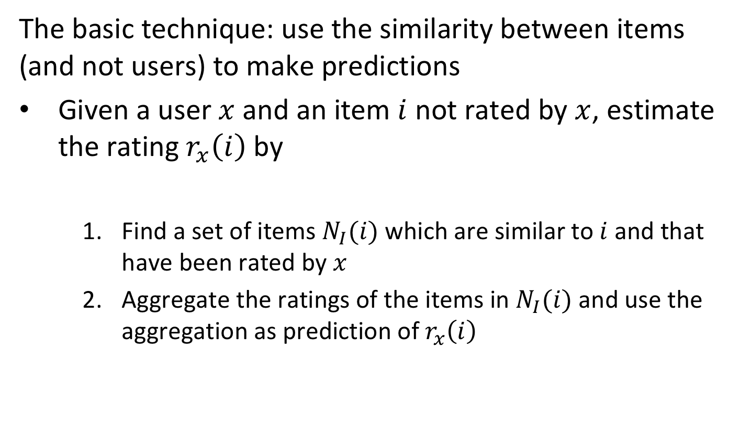
Item-based Collaborative Filtering
The basic technique: use the similarity between items (and not users) to make predictions
Given a user $x$ and an item $i$ not rated by $x$, estimate the rating $r_{x}\left(i\right)$ by
Find a set of items $N_{I}(i)$ which are similar to $i$ and that have been rated by $x$
Aggregate the ratings of the items in $N_{I}(i)$ and use the aggregation as prediction of $r_{x}\left(i\right)$
Notes:
The basic technique for item-based collaborative filtering needs to define
A metric to compute similarity between items
The number of neighbours considered in N_{I}
A way to aggregate the ratings of the items in N_{I}

Slide 15
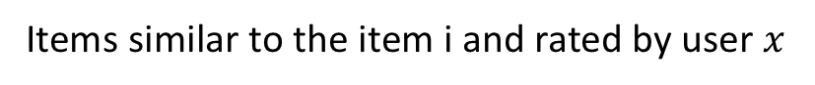
Item-based Collaborative Filtering illustrated
user $x$
item $i$
$r_{x}\left(i\right)$ ?
Aggregate their ratings
Items similar to the item i and rated by user $x$

Slide 16
Similarity Between Items
sim_{corr}(item5, item1) = 0.97
sim_{corr}(item5, item2) = -0.48
sim_{corr}(item5, item3) = -0.43
sim_{corr}(item5, item4) = 0.58
 | Item 1 | Item 2 | Item 3 | Item 4 | Item 5
U | 5 | 3 | 4 | 4 | ???
User 1 | 3 | 1 | 2 | 3 | 3
User 2 | 4 | 3 | 4 | 3 | 5
User 3 | 3 | 3 | 1 | 5 | 4
User 4 | 1 | 5 | 5 | 2 | 1
Notes:
The attributes that define an item are the ratings of the users different than U. The similarity can be computed with the same functions explained before, correlation coefficient or cosine similarity. In this example, similarity is computed with the correlation coefficient, and it is possible to see how item 1 and 4 are the most similar to item 5. Thus, aggregating the ratings of these items given by user U is an estimate of the rating of user U for item 5.

Slide 17
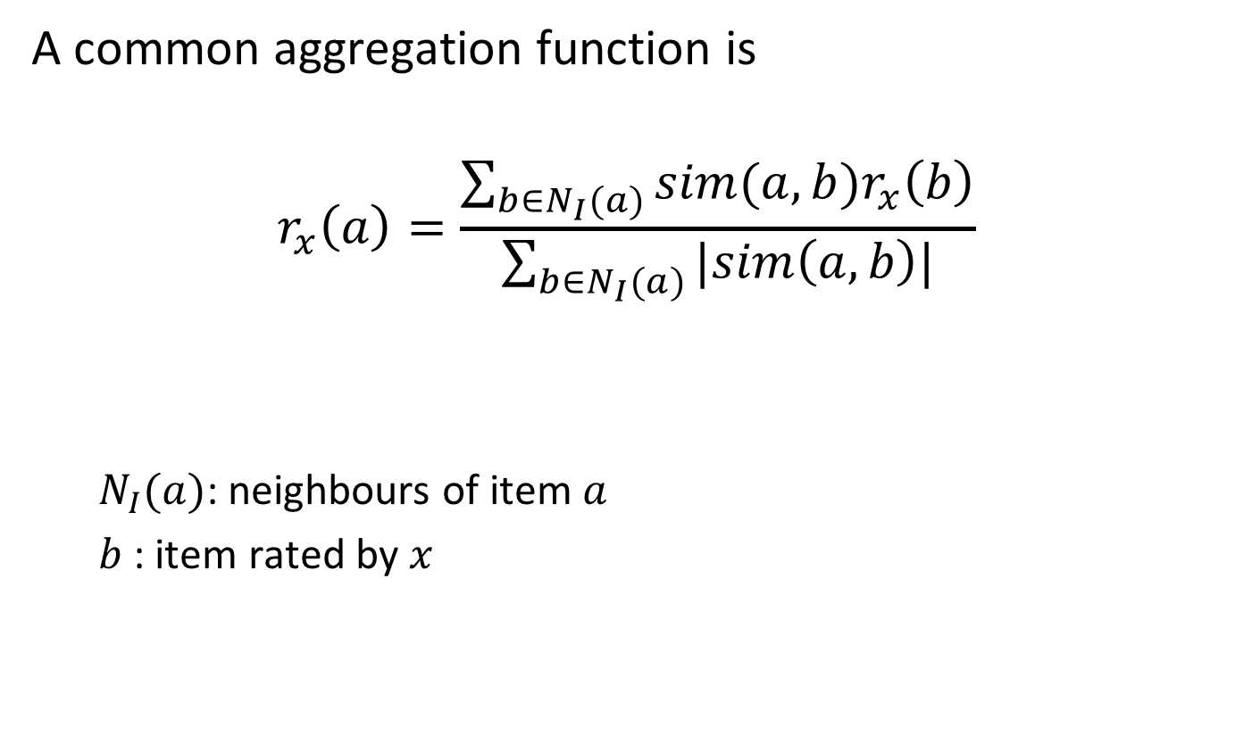
Aggregate the Ratings
A common aggregation function is
$$r_{x}\left(a\right)=\frac{\sum_{b∈N_{I}(a)}{sim(a,b)r_{x}\left(b\right)}}{\sum_{b∈N_{I}(a)}{|sim\left(a,b\right)|}}$$
$N_{I}(a)$: neighbours of item $a$
$b$: item rated by $x$
Notes:
The aggregation function computes the prediction of an item a for a user x by computing the sum of the ratings given by the user on the items similar to a. Each rating is weighted by the corresponding similarity sim(a,b) between items a and b.

Slide 18
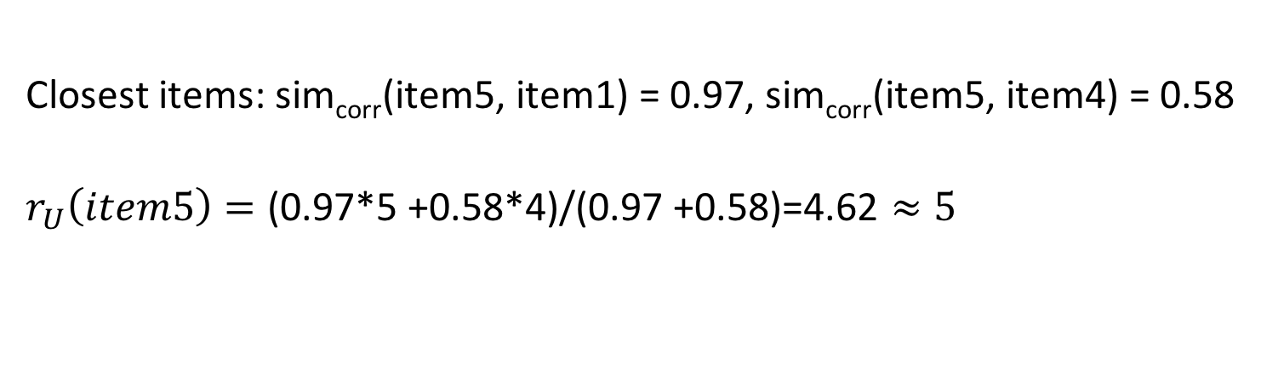
Example
 | Item 1 | Item 2 | Item 3 | Item 4 | Item 5
U | 5 | 3 | 4 | 4 | ???
User 1 | 3 | 1 | 2 | 3 | 3
User 2 | 4 | 3 | 4 | 3 | 5
User 3 | 3 | 3 | 1 | 5 | 4
User 4 | 1 | 5 | 5 | 2 | 1
Closest items: sim_{corr}(item5, item1) = 0.97, sim_{corr}(item5, item4) = 0.58
$$r_{U}\left(item5\right)=\text{(0.97}\text{∗}\text{5 +0.58∗4)}\text{/}\text{(0.97 +0.58)}\text{=4.62}≈5$$

Slide 19
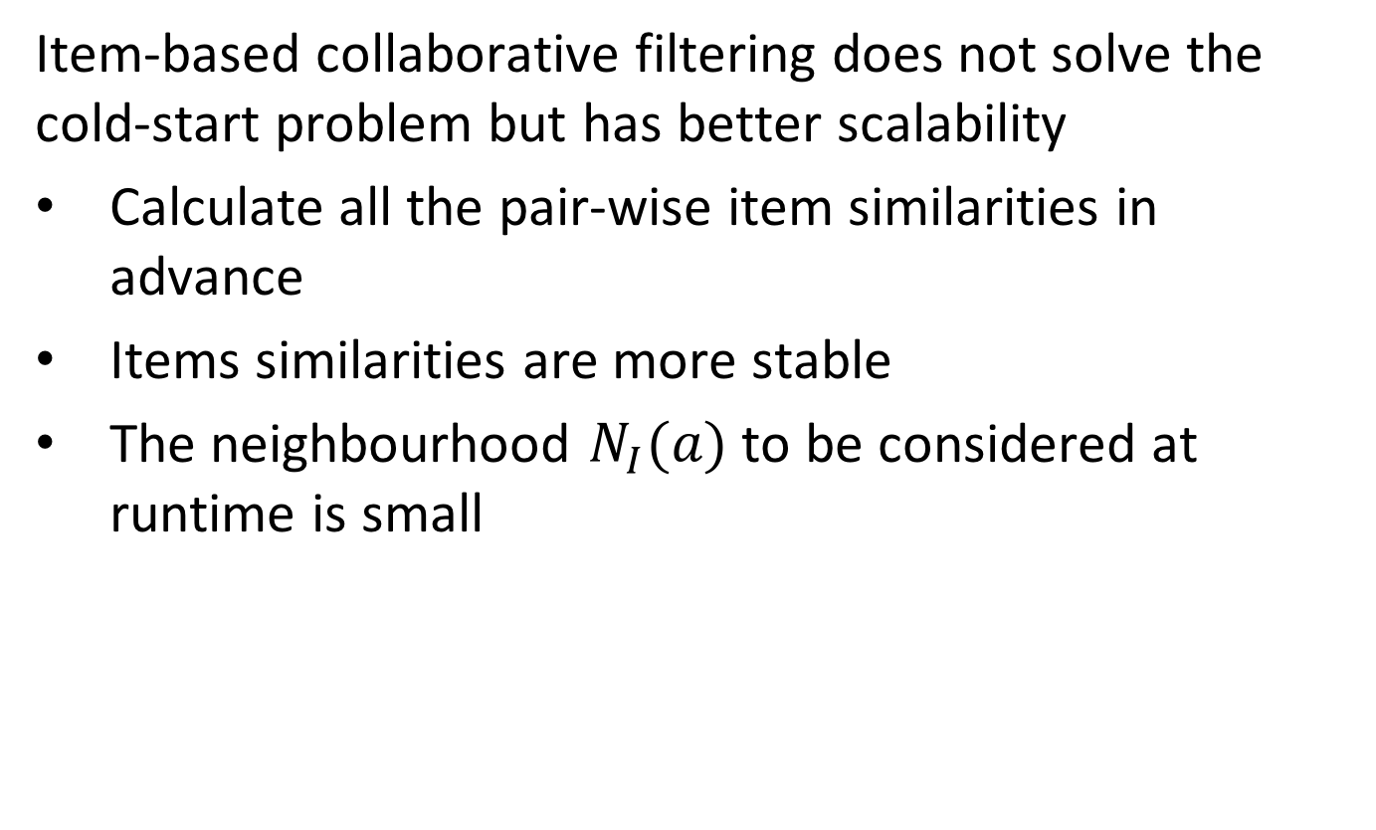
Item-based Collaborative Filtering
Item-based collaborative filtering does not solve the cold-start problem but has better scalability
Calculate all the pair-wise item similarities in advance
Items similarities are more stable
The neighbourhood $N_{I}(a)$ to be considered at runtime is small
Notes:
Although item-based collaborative filtering does not solve the cold-start problem, it is usually more suited to tackle big datasets. In fact, the item similarities can be computed in advance, given that the items are more stable than the users (in general, new items appear at a slower pace than new users). Furthermore, the size of the neighbourhood of a given item a is in general smaller than the neighbourhood of a user x, because $N_{I}(a)$ is composed of the other items rated by user x (e.g., tens of DVDs bought on Amazon), while $N_{U}(x)$ is composed by the other users that rated the same items as x (e.g., millions of users that watched The Godfather on Netflix).

Slide 20
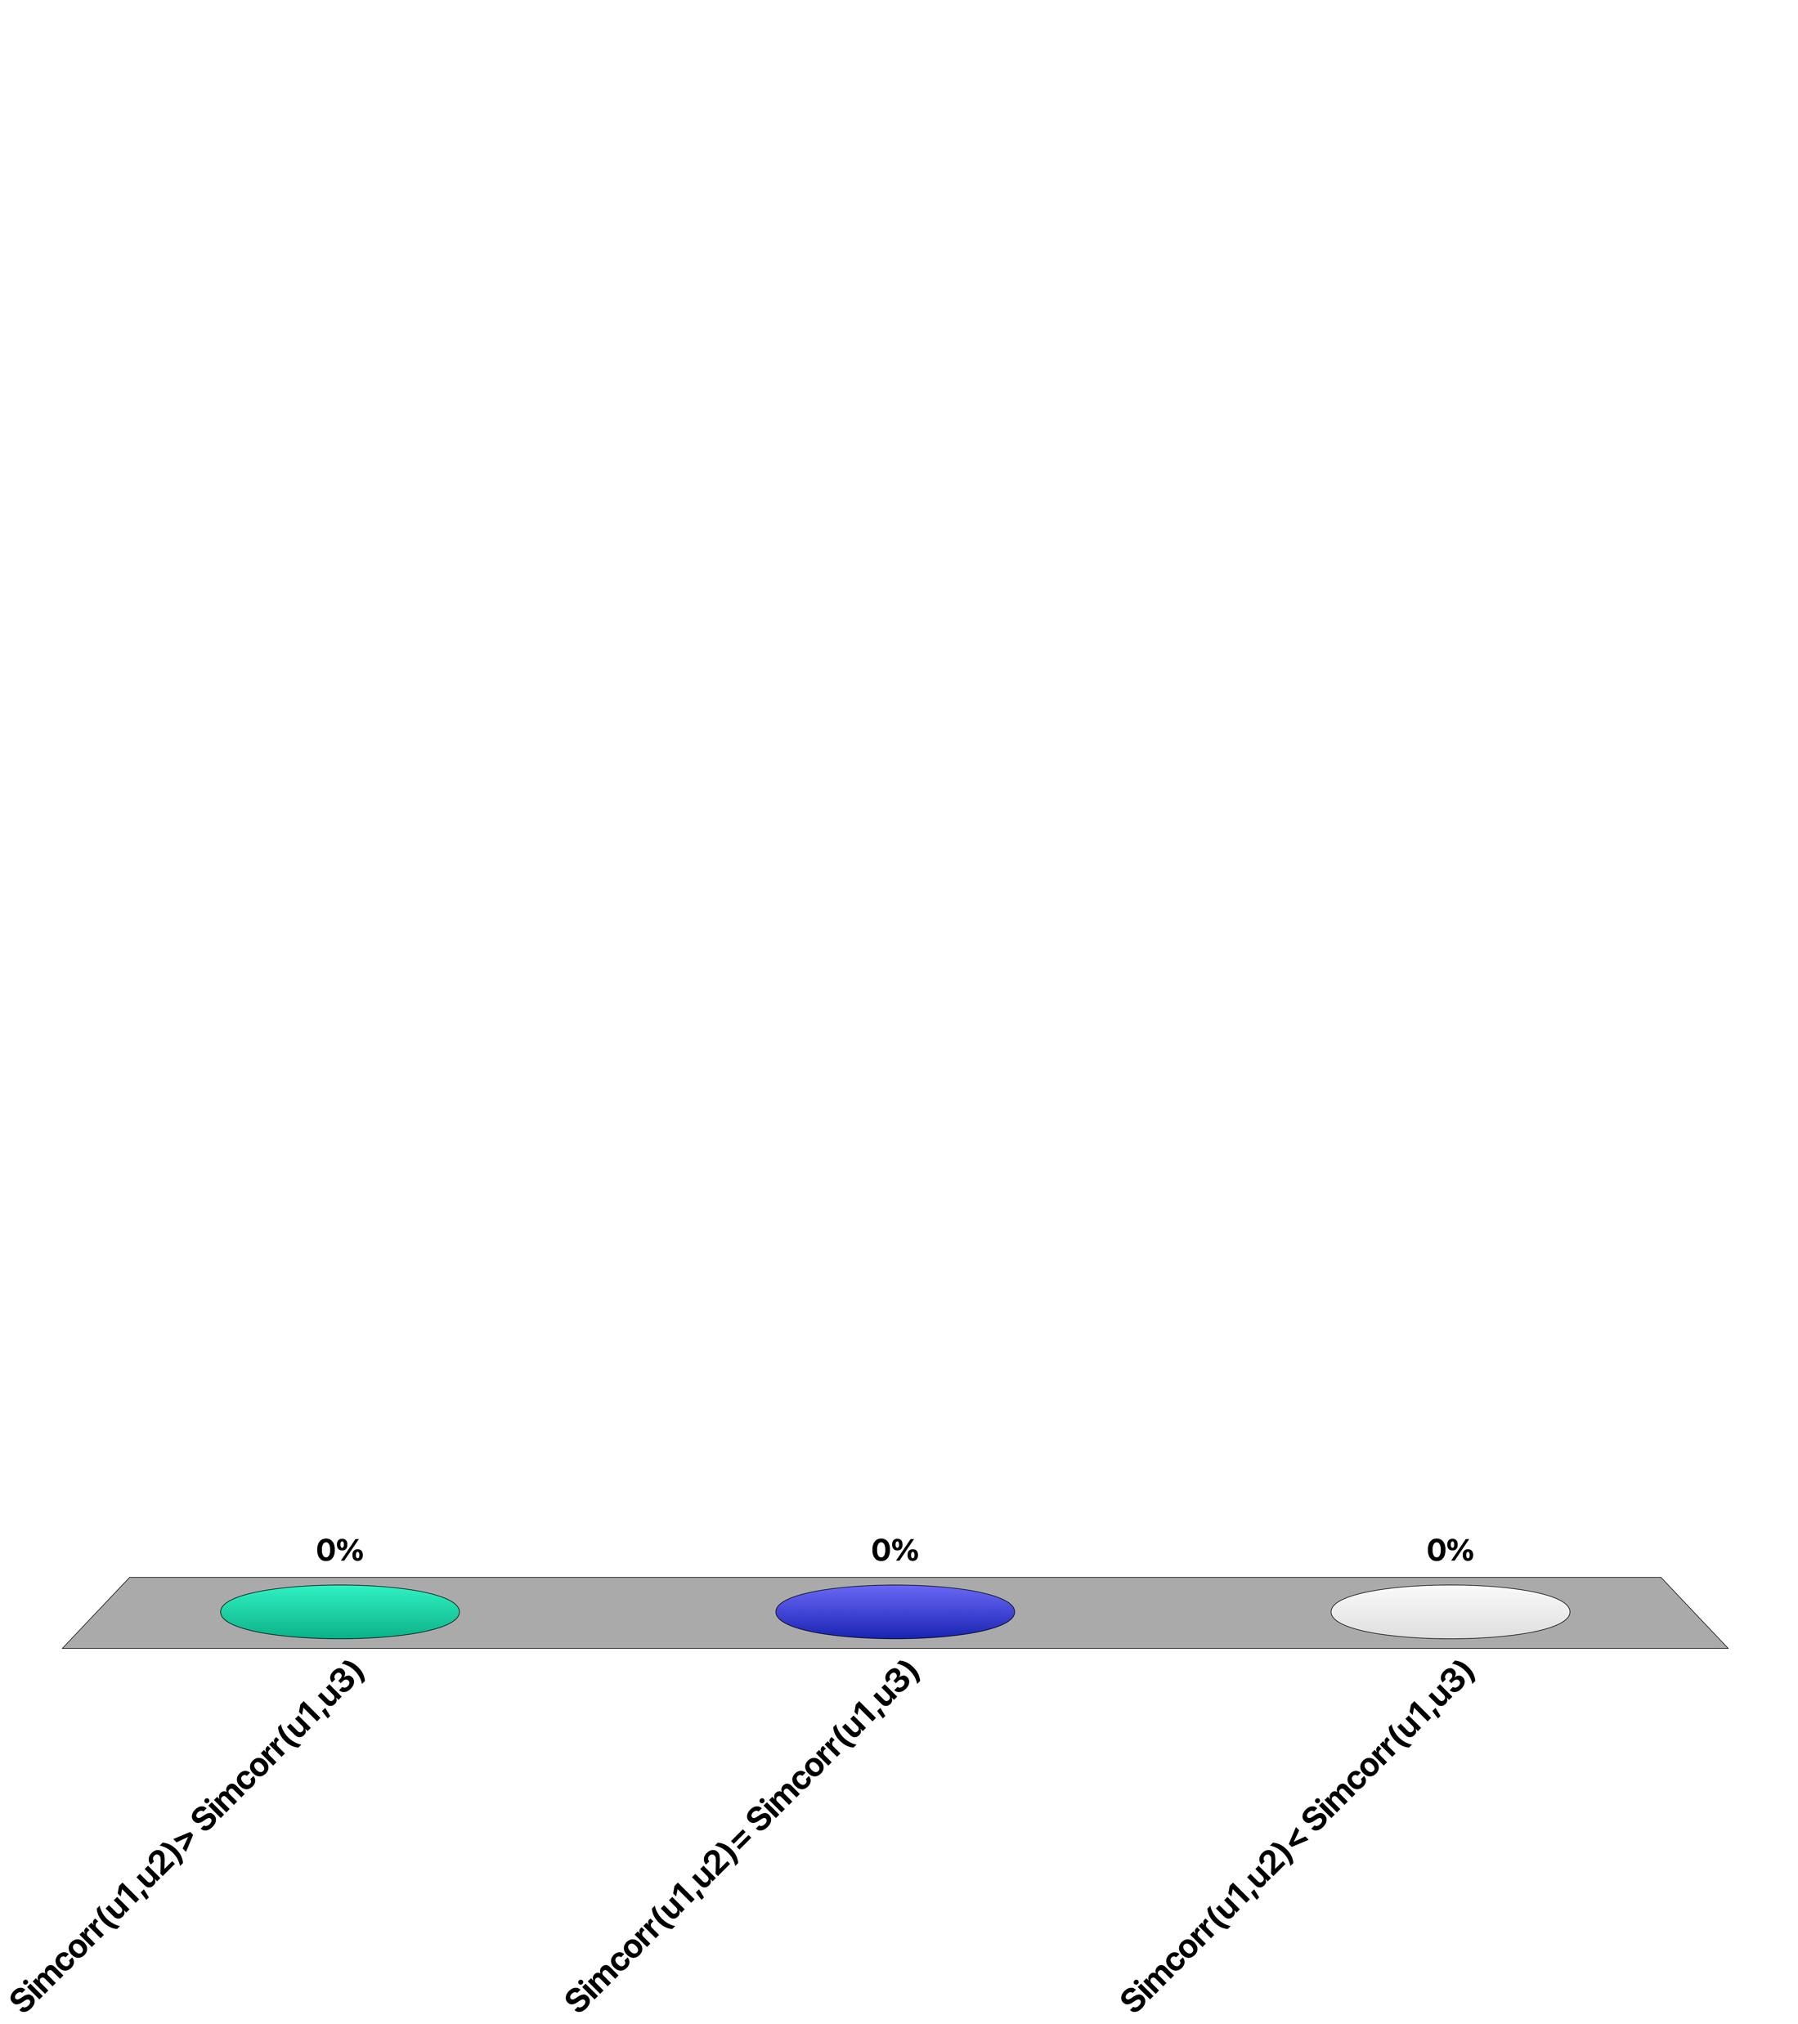
Given 3 users with ratings…
u1: 1 3
u2: 2 4
u3: 1 4
Sim_{corr}(u1, u2) > Sim_{corr}(u1, u3)
Sim_{corr}(u1, u2) = Sim_{corr}(u1, u3)
Sim_{corr}(u1, u2) < Sim_{corr}(u1, u3)

Slide 21
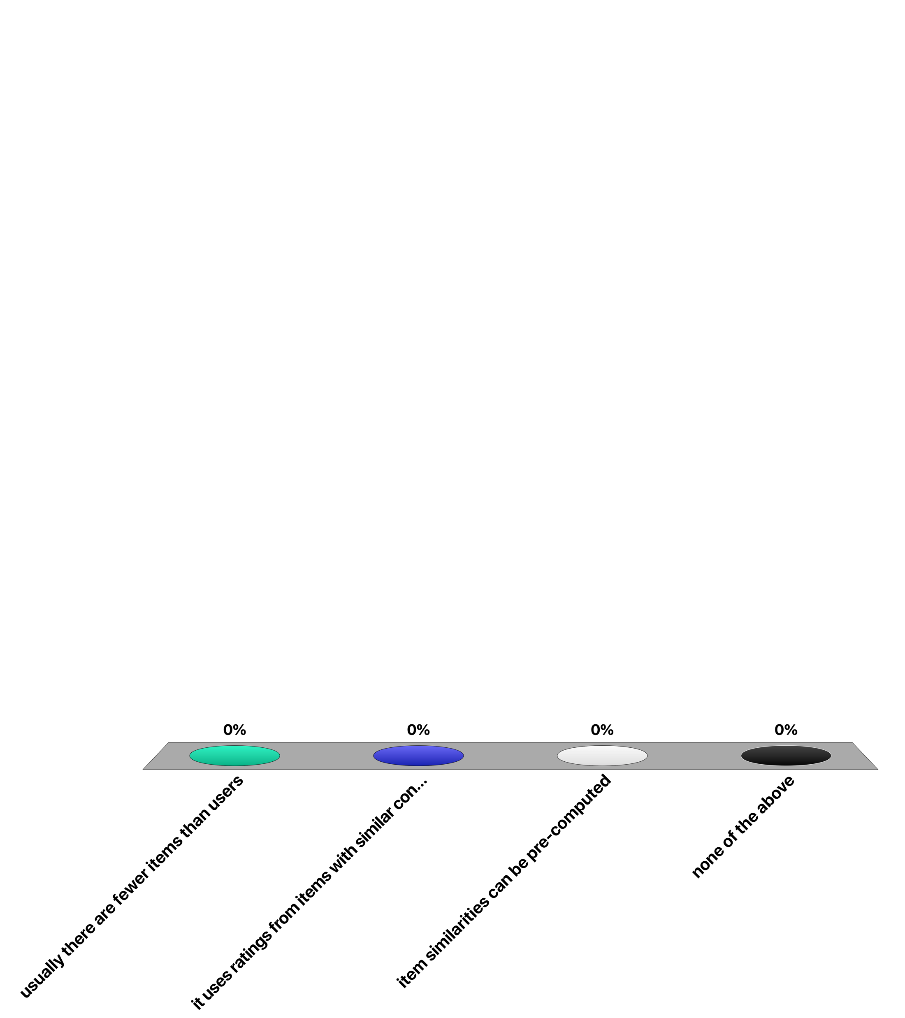
Item-based collaborative filtering addresses better the cold-start problem because …
usually there are fewer items than users
it uses ratings from items with similar content
item similarities can be pre-computed
none of the above

Slide 22
Content-based Recommendation
Collaborative filtering uses only ratings, it does not exploit any other information about the items
However, the content of the item might provide some useful information
E.g., recommend sci-fi novels to users who liked Asimov books in the past
Notes:
Both recommendation techniques we saw before need only the ratings of the user, and no information about the item is needed. However, the content of the item might provide useful information for the recommendation. Content-based recommendation takes into consideration only the items that have been rated by the user and the content of all existing items, significantly reducing the scalability problems since a community of users is not necessary any more.

Slide 23
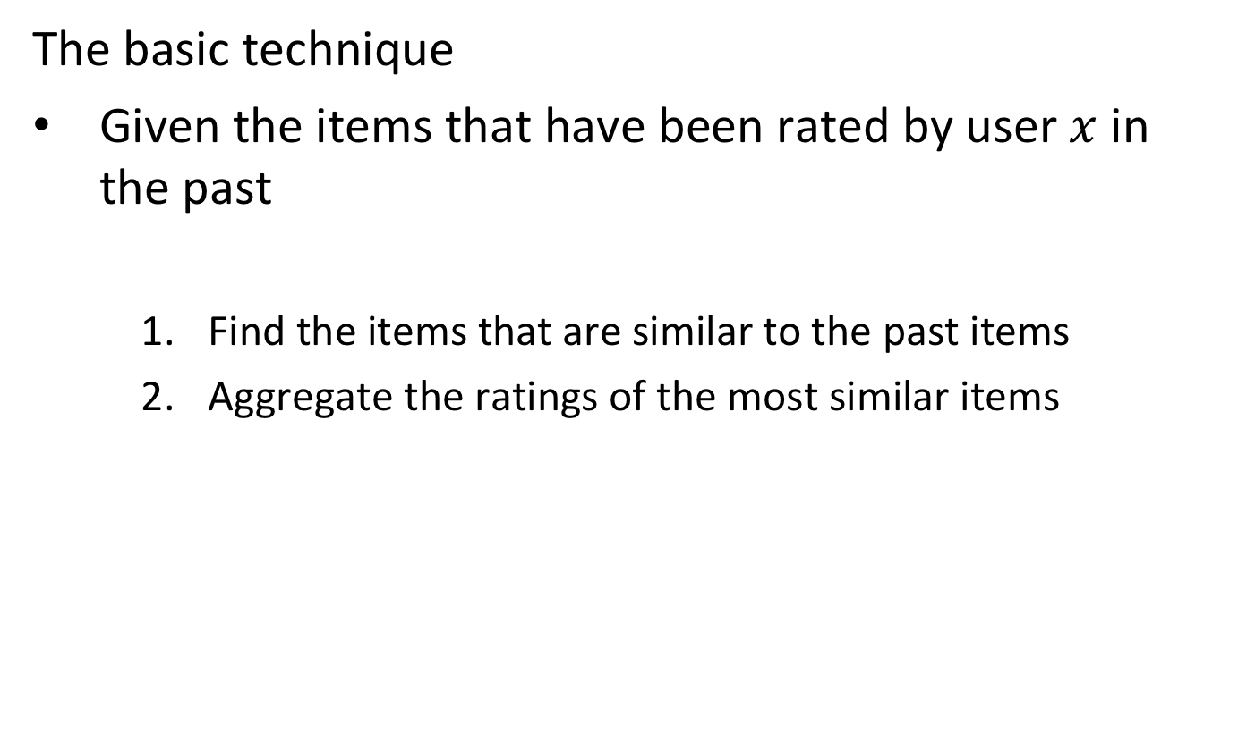
Content-based Recommendation
The basic technique
Given the items that have been rated by user $x$ in the past
Find the items that are similar to the past items
Aggregate the ratings of the most similar items
Notes:
The basic technique for content-based recommendation needs to define
A way to formalize the item content
A similarity measure between items
An aggregation function for the ratings

Slide 24
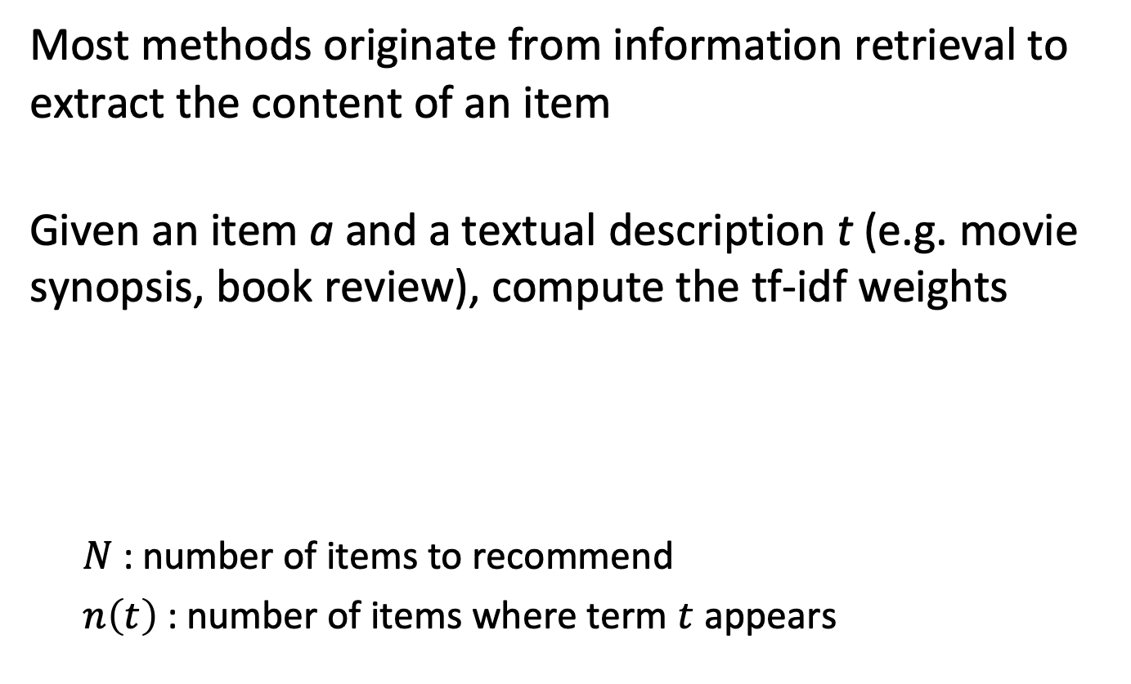
Content-based Recommendation
Most methods originate from information retrieval to extract the content of an item
Given an item a and a textual description t (e.g. movie synopsis, book review), compute the tf-idf weights
$N$: number of items to recommend
$n\left(t\right)$: number of items where term $t$ appears
Notes:
The first step for content-based recommendation is the characterisation of the items in terms of TF-IDF. Each item can be therefore described by the set of terms that appear in their description, with their associated weight (the TF-IDF measure)
To compute the TF-IDF measure, all the steps typical of information retrieval (removing stopwords, stemming, only top M terms etc.) are applied.

Slide 25
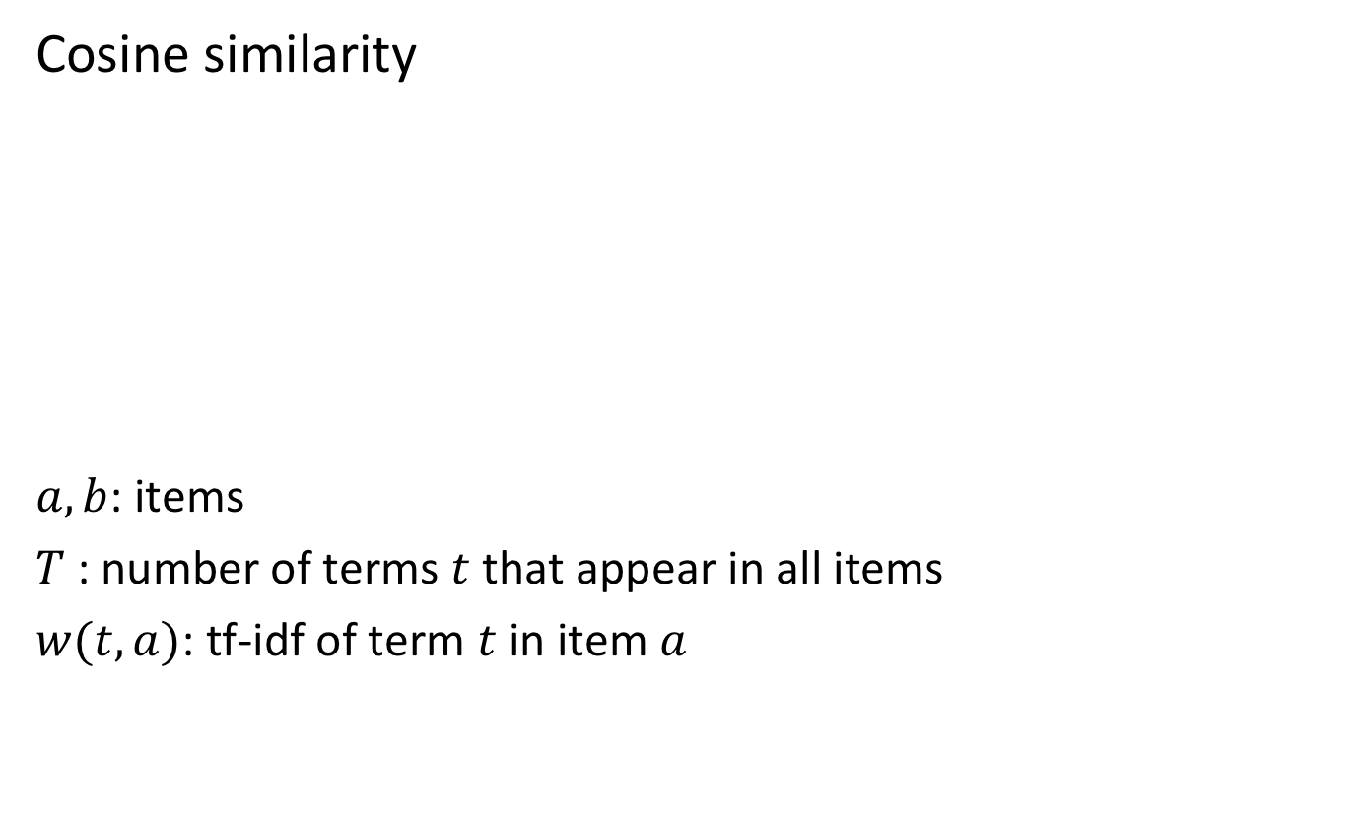
Similarity between Items
Cosine similarity
$a, b$: items
$T$ : number of terms $t$ that appear in all items
$w(t,a)$: tf-idf of term $t$ in item $a$
Notes:
The cosine similarity in content-based recommendation considers the items a and b as two T-dimensional vectors, where each dimension is the TF-IDF measure of a specific term t.

Slide 26
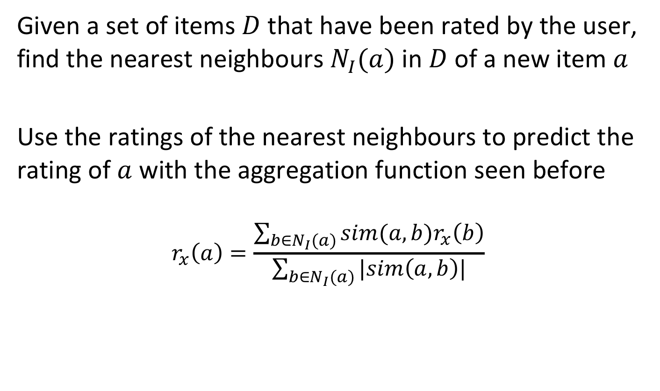
Making Predictions
Given a set of items $D$ that have been rated by the user, find the nearest neighbours $N_{I}(a)$in $D$ of a new item $a$
Use the ratings of the nearest neighbours to predict the rating of $a$ with the aggregation function seen before
$$r_{x}\left(a\right)=\frac{\sum_{b∈N_{I}(a)}{sim(a,b)r_{x}\left(b\right)}}{\sum_{b∈N_{I}(a)}{|sim\left(a,b\right)|}}$$
Notes:
Once a way to compute the similarity between items has been established, using the vector space model (TF-IDF + cosine similarity), the simplest approach to estimate the rating of item a not yet seen/rated by user x is to find the nearest neighbours of a in the subset of items that have been already rated by the user x and aggregate their ratings. Note that this approach to predict the rating is analogous to the use of the kNN nearest neighbor classification for document classification. In both cases, the nearest documents are used as predictors for the most likely label respectively rating.

Slide 27
Content-based Recommendation
Problems
Cold start problem for users with no ratings
Content can be limited or impossible to extract (multimedia)
Tends to recommend “more of the same”
Scalable: tf-idf of items can be computed offline
Notes:
Content-based recommendation also suffers from the cold start problem as collaborative filtering, but only for the users that did not rate anything in the past. Another problem is that sometimes the information available to extract the content is limited (e.g., movie synopsis versus full plot) or impossible to process (e.g. a sound or a video). Finally, content-based recommendation tends to recommend more of the same, it does not surprise the user with new interesting items.
On the other hand, it is in general more scalable, because it does not rely on a community of users to provide recommendations. Furthermore, the TF-IDF measure can be computed once a new item enters the system, and then update the pair-wise similarities with all the existing items.

Slide 28
For a user that has not done any ratings, which method can make a prediction?
User-based collaborative RS
Item-based collaborative RS
Content-based RS
None of the above

Slide 29
For an item that has not received any ratings, which method can make a prediction?
User-based collaborative RS
Item-based collaborative RS
Content-based RS
None of the above

Slide 30
Advanced Methods: Matrix Factorization
Comedy
User
Item
 | I1 | I2 | I3 | I4
U1 | 3 | 1 | - | -
U2 | - | 3 | 4 | 3
U3 | 3 | - | 1 | -
U4 | - | 5 | 5 | 2
Violence
Romance
Drama
Map into latent space
Notes:
Matrix factorization transforms the user-item rating matrix into a latent factor model, where each user and item is described as a vector in a k-dimensional space. It can be understood as a combination of user-based and item-based collaborative filtering.
For the items, the factors describe evident as well as non interpretable characteristics. For the users, each factor measures how much the user likes items that score high on the corresponding factor. The estimate of the rating of item a that user u would given can be computed as the dot product between the two low-dimensional matrices: q_{i}^{T} ∙ p_{u} where q_{i} is the item vectors and p_{u} is the user vectors. The major challenge of course is computing the mapping of each item and user to their corresponding vectors in q_{i} and p_{u}. After that, the rating can be estimated using the dot product.
This approach is analogous to singular value decomposition for document retrieval. However, a direct application of SVD is not possible because the user-item matrix is not complete (missing ratings).

Slide 31
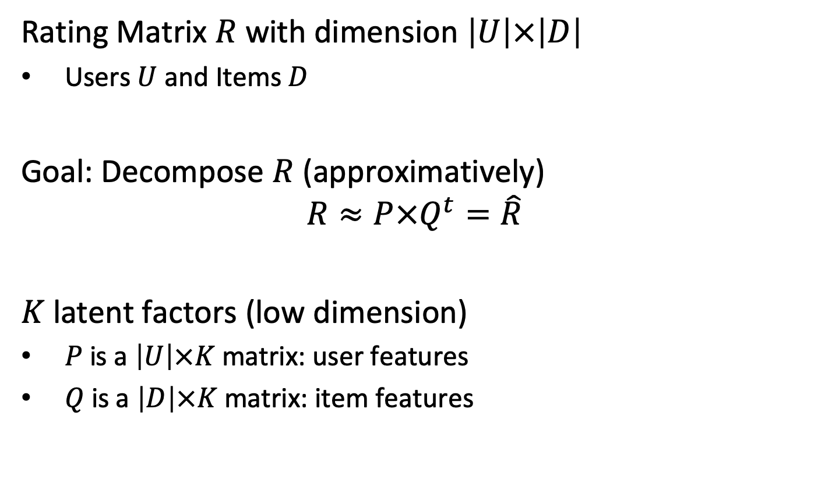
Derive Latent Factors
Rating Matrix $R$ with dimension $\left|U\right|×\left|D\right|$
Users $U$ and Items $D$
Goal: Decompose $R$ (approximatively)
$$R≈P×Q^{t}=\hat{R}$$
$K$ latent factors (low dimension)
$P$ is a $\left|U\right|×K$matrix: user features
$Q$ is a $\left|D\right|×K$matrix: item features
Notes:
Here we formulate the factorization problem.

Slide 32
Illustration of Matrix Factorization
|D|
K
|D|
|U|
R
=
P
•
Q^{t}
K
Item vectors
User vectors

Slide 33
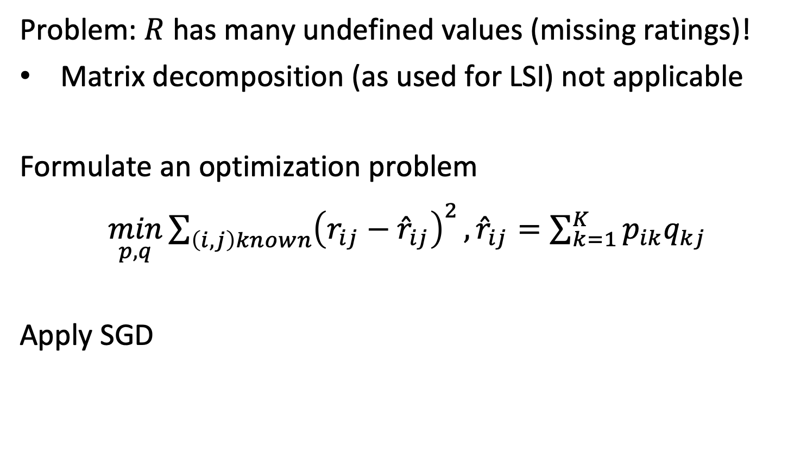
Computing Matrix Factorization
Problem: $R$ has many undefined values (missing ratings)!
Matrix decomposition (as used for LSI) not applicable
Formulate an optimization problem
$\min_{p,q}{\sum_{\left(i,j\right)known}{{\left(r_{ij}−{\hat{r}}_{ij}\right)}^{2}}},{\hat{r}}_{ij}=\sum_{k=1}^{K}{p_{ik}q_{kj}}$
Apply SGD

Slide 34
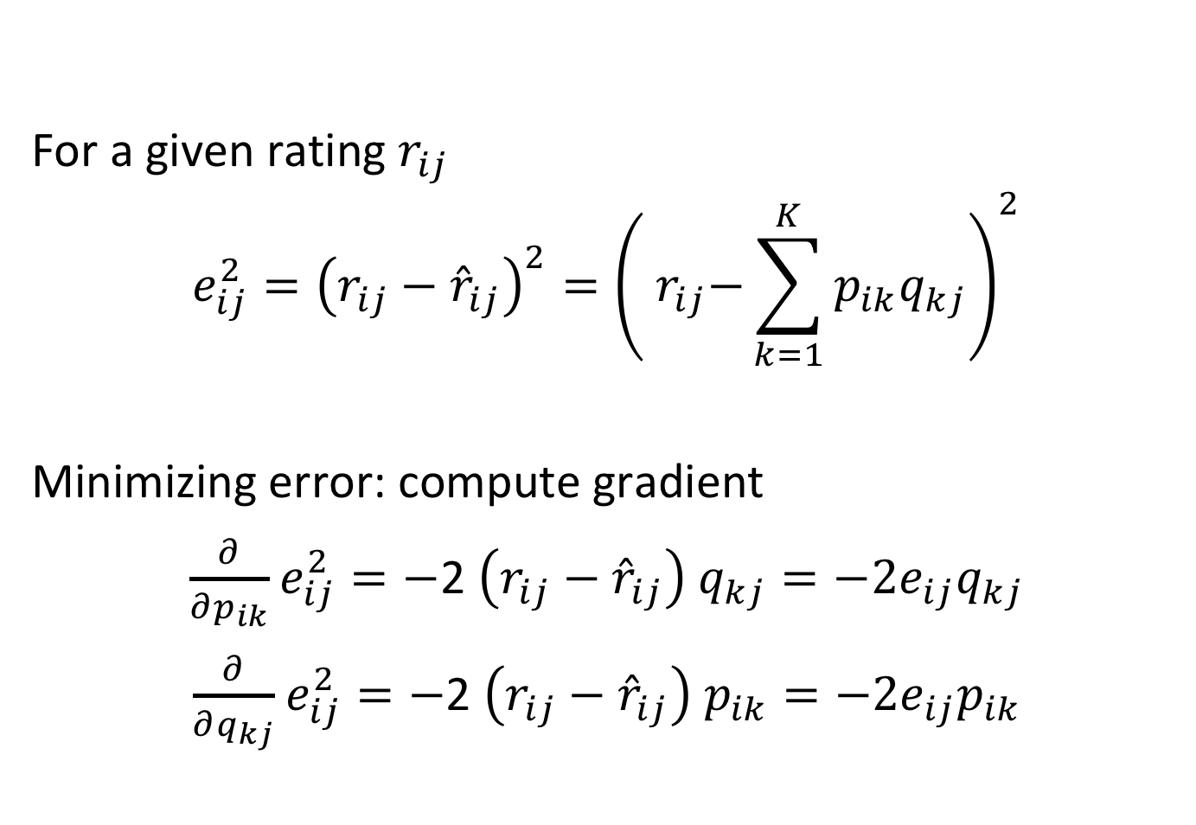
Approximation Error
For a given rating $r_{ij}$
$$e_{ij}^{2}={\left(r_{ij}−{\hat{r}}_{ij}\right)}^{2}={\left({ r}_{ij}−\sum_{k=1}^{K}{p_{ik}q_{kj}}\right)}^{2}$$
Minimizing error: compute gradient
$\frac{∂}{∂p_{ik}}$ $e_{ij}^{2}=−$2 $\left(r_{ij}−{\hat{r}}_{ij}\right)$ $q_{kj}=−2e_{ij}q_{kj}$
$\frac{∂}{∂q_{kj}}$ $e_{ij}^{2}=−$2 $\left(r_{ij}−{\hat{r}}_{ij}\right)$ $p_{ik}=−2e_{ij}p_{ik}$
Notes:
Thus, to learn the factor vectors q_{i} and p_{u} the system minimises the regularised square error on the set of known ratings (u,i) ∈ M. The minimization problem can be solved using stochastic gradient descent. To that end we first compute the gradients.

Slide 35
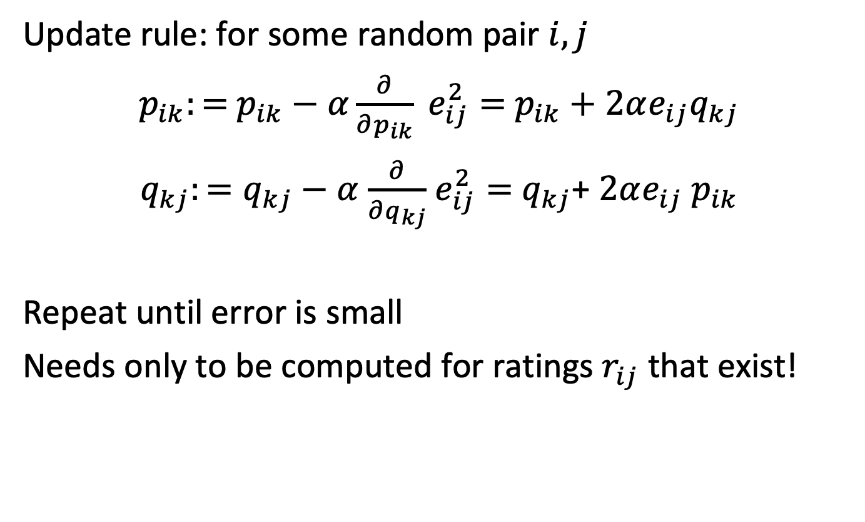
Stochastic Gradient Descent
Update rule: for some random pair $i,j$
$p_{ik}:=$ $p_{ik}−α\frac{∂}{∂p_{ik}} e_{ij}^{2}=$ $p_{ik}+2αe_{ij}q_{kj}$
$q_{kj}:=q_{kj}−α$ $\frac{∂}{∂q_{kj}}$ $e_{ij}^{2}=$ $q_{kj}$+ $2αe_{ij}$ $p_{ik}$
Repeat until error is small
Needs only to be computed for ratings $r_{ij}$ that exist!
Notes:
With the gradients we can then define the update rules. Since we perform SGD, we need only to update error values for which a corresponding rating exists. As a side effect, once the decomposition is computed, we obtain also estimates for the ratings for the other user-item pairs, for which not rating exists in the training data.

Slide 36
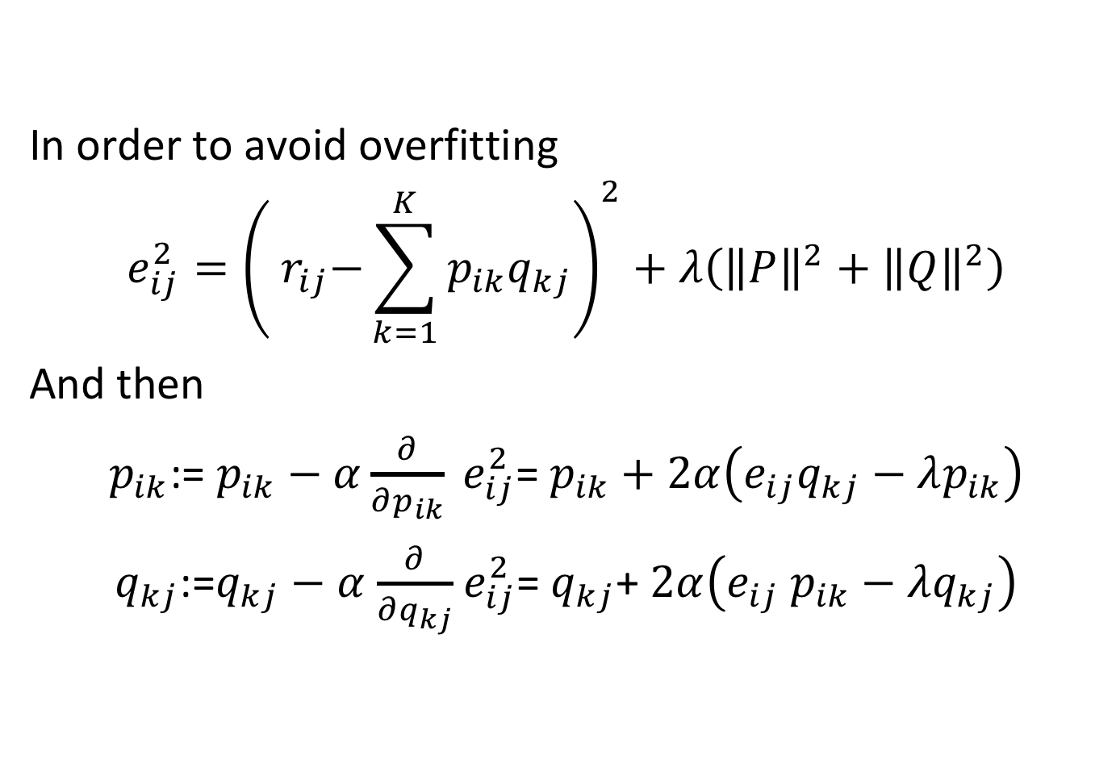
Regularization
In order to avoid overfitting
$$e_{ij}^{2}={\left({ r}_{ij}−\sum_{k=1}^{K}{p_{ik}q_{kj}}\right)}^{2}+λ\left({\left\|P\right\|}^{2}+{\left\|Q\right\|}^{2}\right)$$
And then
$p_{ik}$:= $p_{ik}−α\frac{∂}{∂p_{ik}} e_{ij}^{2}$= $p_{ik}+2α\left(e_{ij}q_{kj}−λp_{ik}\right)$
$q_{kj}$:=$q_{kj}−α$ $\frac{∂}{∂q_{kj}}$ $e_{ij}^{2}$= $q_{kj}$+ $2α\left(e_{ij} p_{ik}−λq_{kj}\right)$
Notes:
In order to avoid over-fitting, usually a regularization term is added and the update rule is modified correspondingly.

Slide 37
Issues with Basic Matrix Factorization
Matrix P grows with number of users
Problematic with large user populations, e.g. social networks
Users modelled individually
Many models to manage
Training becomes expensive
Large training matrix
Notes:
The main drawback of matrix factorization is that it scales with the number of users, which in real world scenarios can become very large (e.g. customers of an ecommerce or streaming service).

Slide 38
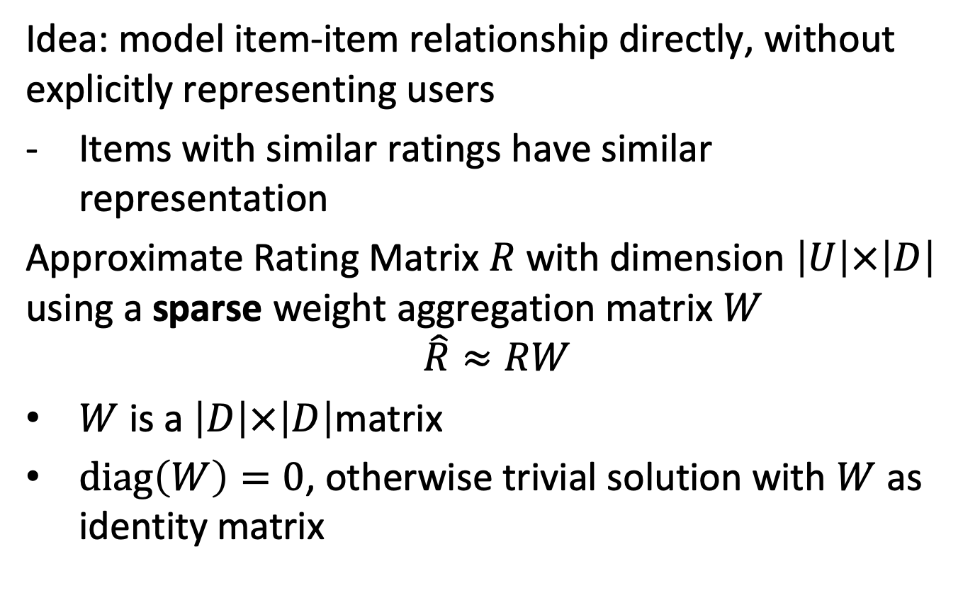
SLIM, Sparse Linear Methods
Idea: model item-item relationship directly, without explicitly representing users
Items with similar ratings have similar representation
Approximate Rating Matrix $R$ with dimension $\left|U\right|×\left|D\right|$ using a sparse weight aggregation matrix $W$
$$\hat{R}≈RW$$
$W$ is a $\left|D\right|×\left|D\right|$matrix
$diag\left(W\right)=0$, otherwise trivial solution with $W$ as identity matrix
Notes:
In order to overcome the issue of scaling with the user population, alternative models have been considered. SLIM is a representative of those.
It is based on the idea to a create a representation of items, such that items with similar ratings have a similar representation. Thus it is comparable to the idea of item-based collaborative recommender algorithms, that we have introduced earlier. The difference is that instead of comparing items by their full rating vector, consisting of the ratings of the full user population, a sparse representation of item vectors is derived. This sparse representation that is encoded in a weight aggregation matrix W allows to recover the rating of an item from (a few) ratings from similar items.

Slide 39
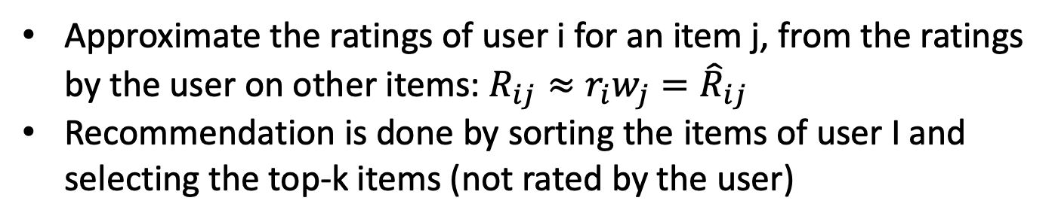
Illustration
Sparse column w_{j} corresponding to item j
column c_{j} corresponding some item j
R
W
row r_{i} corresponding to user i
W_{jj} = 0
Approximate the ratings of user i for an item j, from the ratings by the user on other items: $R_{ij}≈r_{i}w_{j}={\hat{R}}_{ij}$
Recommendation is done by sorting the items of user I and selecting the top-k items (not rated by the user)
Notes:
What approximating the rating for a given user i, the item vector i (which contains the ratings of the user) is multiplied with the corresponding column form W.
In typical experiments, only about 1% of the values of W would be non-zero, which explains why the method can make recommendations faster, since the product $r_{i}w_{j}$ can be computed fast.

Slide 40
Example
R
Optimal vector to recover original rating
Sparse vector to recover original rating
 | Item 1 | Item 2 | Item 3 | Item 4 | Item 5
U | 5 | 3 | 4 | 4 | 5
User 1 | 3 | 1 | 2 | 3 | 3
User 2 | 4 | 3 | 4 | 3 | 5
User 3 | 3 | 3 | 1 | 5 | 4
User 4 | 1 | 5 | 5 | 2 | 1
Id 5
0
0
0
0
1
w 5
0.6
0
0
0.4
0
Approximate ratings for item 5 using w₅
U: 0.6*5 + 0.4*4 = 4.6
User 1: 0.6*3 + 0.4*3 = 3
User 2: 0.6*4 + 0.4*3 = 3.6
… optimize vector w₅
Notes:
In this example we illustrate the idea:
In item-based collaborative filtering we reconstructed an unknown rating (e.g. item 5 of user U) by considering the ratings of the most similar users for item 5.
With sparse approximation, we try to find for each item (e.g. item 5) a combination of other items that allow to reconstruct the ratings of item 5 for each user (e.g. items 1 and 4 to reconstruct item 5). This vector cannot contain a 1 on the diagonal, otherwise it would be trivial to reconstruct the rating of item 5.

Slide 41
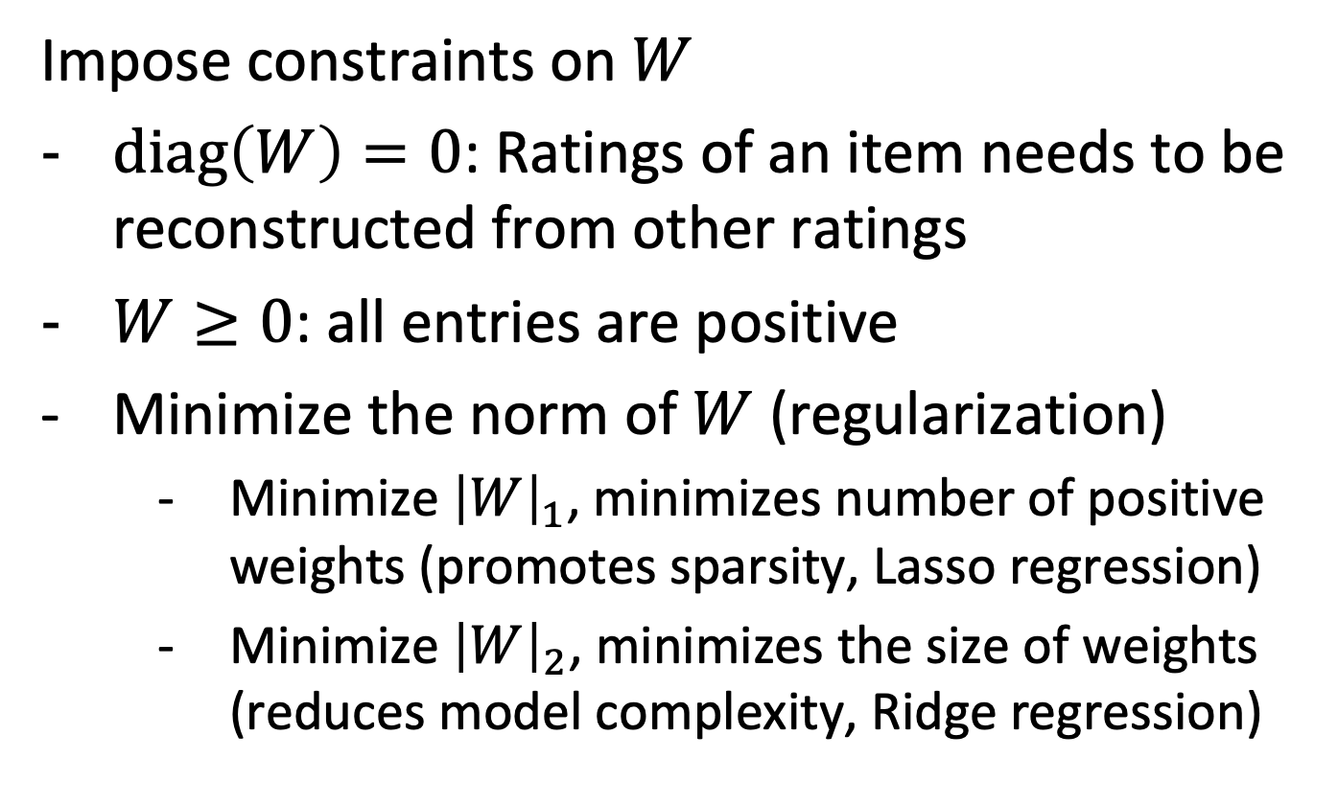
Weight Aggregation Matrix
Impose constraints on $W$
$diag\left(W\right)=0$: Ratings of an item needs to be reconstructed from other ratings
$W≥0$: all entries are positive
Minimize the norm of $W$ (regularization)
Minimize ${\left|W\right|}_{1}$, minimizes number of positive weights (promotes sparsity, Lasso regression)
Minimize ${\left|W\right|}_{2}$, minimizes the size of weights (reduces model complexity, Ridge regression)
Notes:
In order to enforce sparsity of the matrix in the loss function the 1-norm of W is minimized. In addition, in order reduce the size of weights the 2-norm is minimized. These are standard techniques from machine learning.

Slide 42
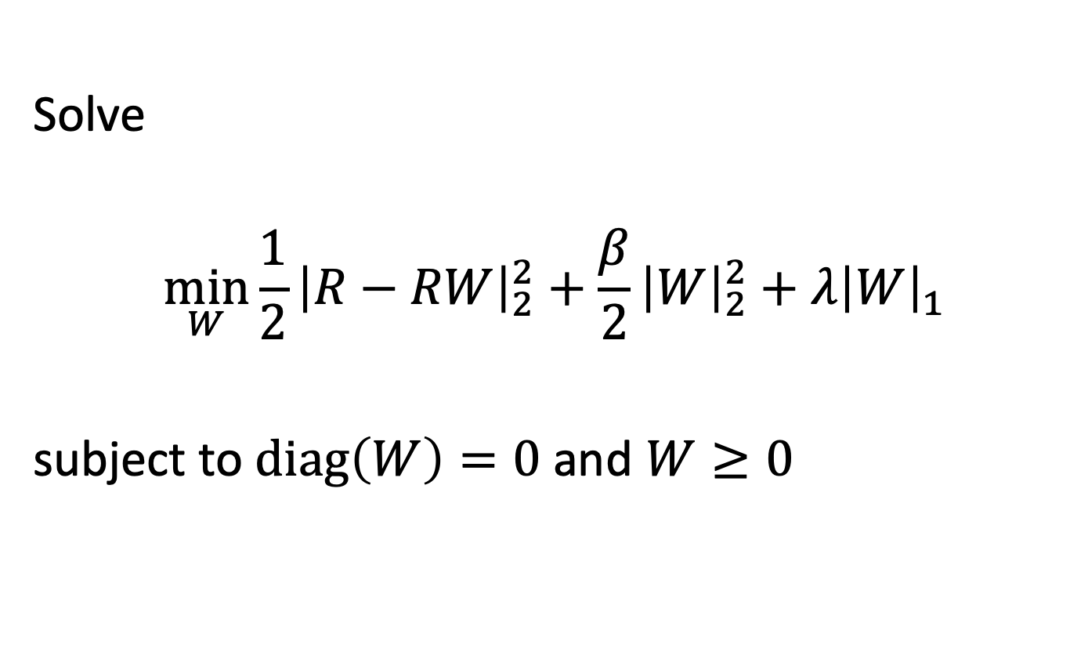
Optimization Problem
Solve
$$\min_{W}{\frac{1}{2}{\left|R−RW\right|}_{2}^{2}+\frac{β}{2}{\left|W\right|}_{2}^{2}+λ{\left|W\right|}_{1}}$$
subject to $diag\left(W\right)=0$ and $W≥0$
Notes:
This is the optimization problem to be solved in order to obtain the sparse matrix W.

Slide 43
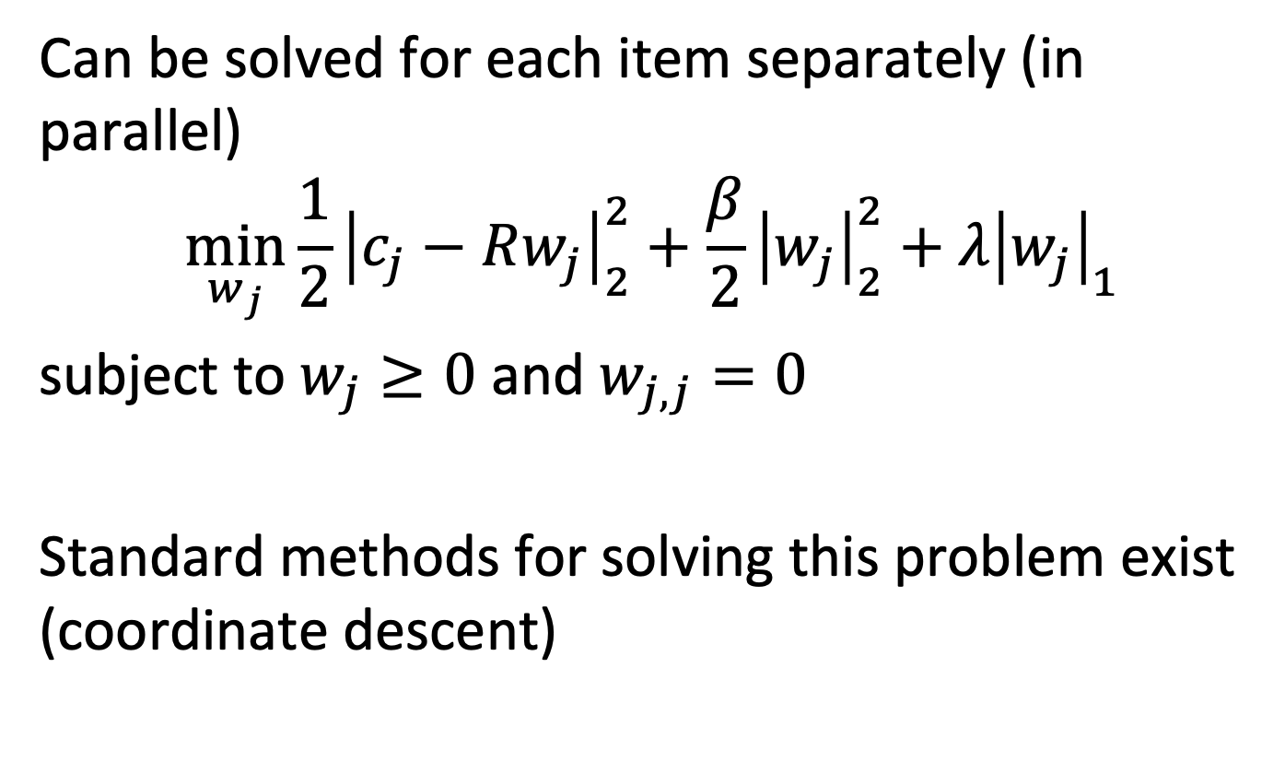
Solving the Problem
Can be solved for each item separately (in parallel)
$$\min_{w_{j}}{\frac{1}{2}{\left|c_{j}−Rw_{j}\right|}_{2}^{2}+\frac{β}{2}{\left|w_{j}\right|}_{2}^{2}+λ{\left|w_{j}\right|}_{1}}$$
subject to $w_{j}≥0$ and $w_{j,j}=0$
Standard methods for solving this problem exist (coordinate descent)
Notes:
Since the columns of W are independent the problem can be solved in parallel for each item. For this standard coordinate descent methods can be applied (i.e. the function is iteratively optimized using gradient descent along the different coordinates).

Slide 44
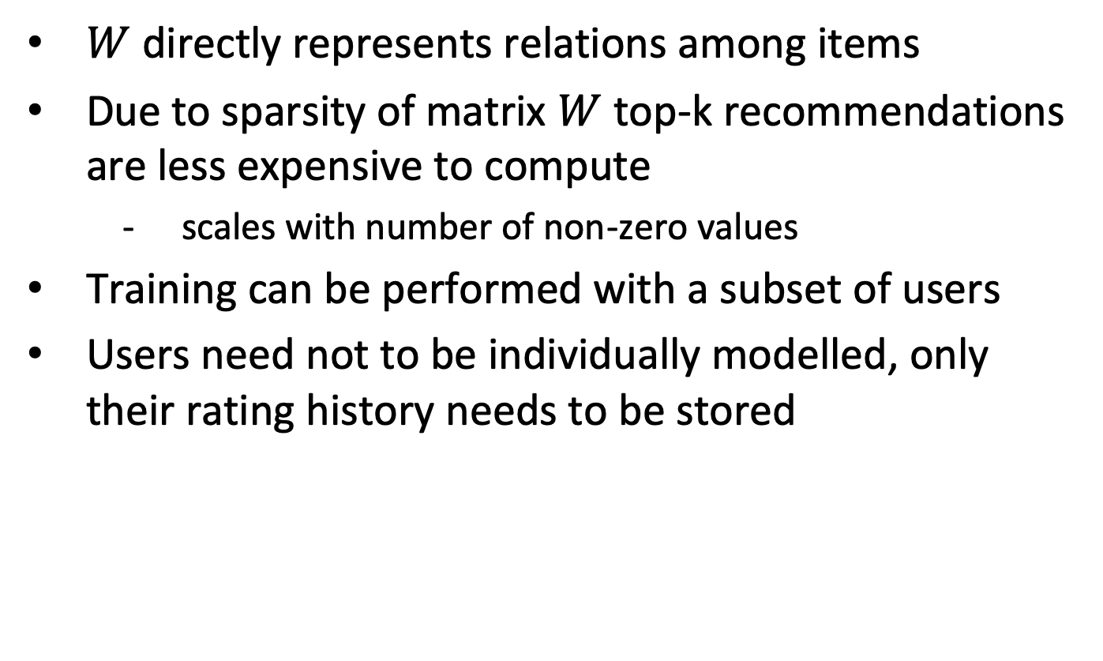
Properties
$W$ directly represents relations among items
Due to sparsity of matrix $W$ top-k recommendations are less expensive to compute
scales with number of non-zero values
Training can be performed with a subset of users
Users need not to be individually modelled, only their rating history needs to be stored

Slide 45
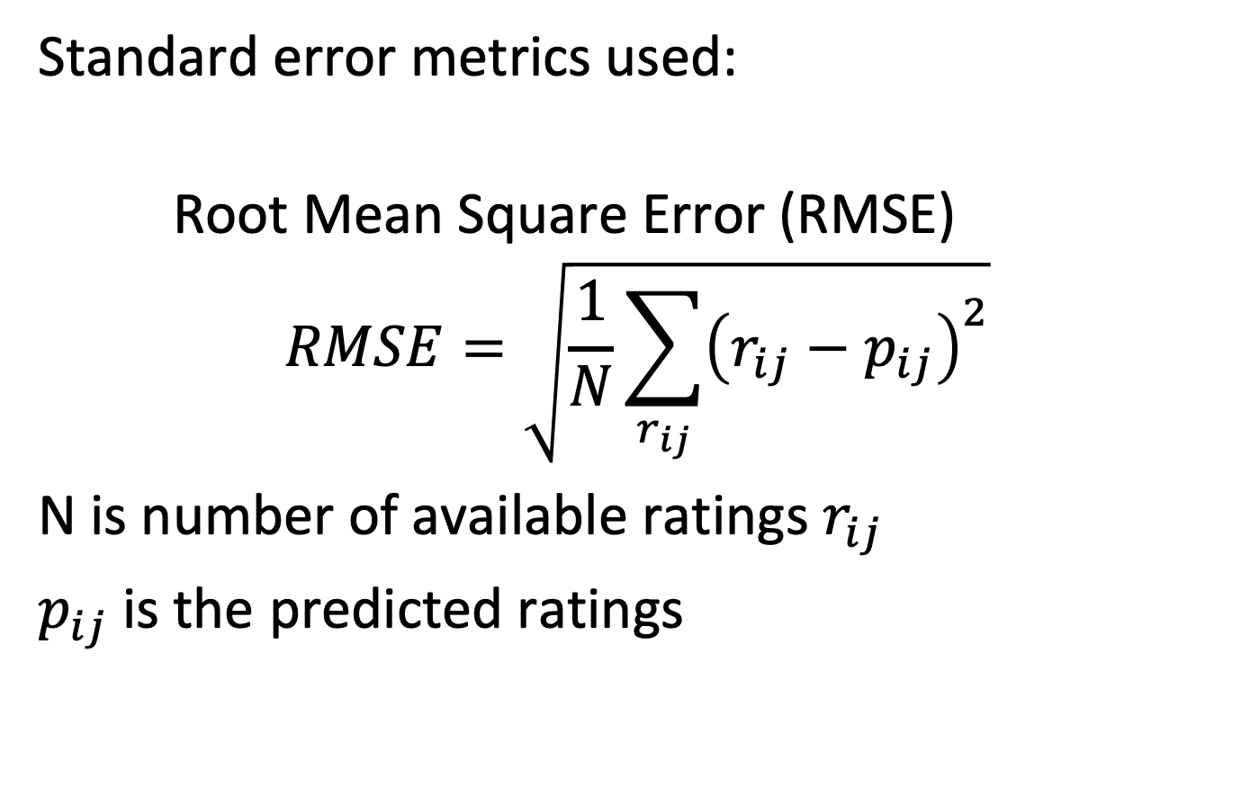
Evaluation of Recommender System
Standard error metrics used:
Root Mean Square Error (RMSE)
$$RMSE=\sqrt{\frac{1}{N}\sum_{r_{ij}}{{\left(r_{ij}−p_{ij}\right)}^{2}}}$$
N is number of available ratings $r_{ij}$
$p_{ij}$ is the predicted ratings
Notes:
A simple standard metrics to evaluate globally the quality of a recommend system is RSME. It compares the known ratings to the predicted ratings, using l2-norm.

Slide 46
RMSE
RMSE corresponds to the optimization objective used in matrix factorization
RMSE can be evaluated
Globally, averaging over all ratings
per-user/per-item with averaging over all users/items
Notes:
RMSE can be evaluated using different strategies, either globally over all items, or first by computing the RMSE for items/users separately and then averaging the resulting values.

Slide 47
Evaluating Ranking Quality
Frequently only the most relevant items are recommended: evaluate the quality of the top-k recommendations
Various methods
Non-discounted cumulative gain (NDCG)
Mean reciprocal rank
Hit rate
Notes:
RMSE is not an adequate metric, if one is only interested into the top-k recommendations, as they are usually provided in practical settings. Therefore various ranking metrics that consider the quality of the top-k recommended items are used.
We will among those introduce in more detail the NDCG.

Slide 48
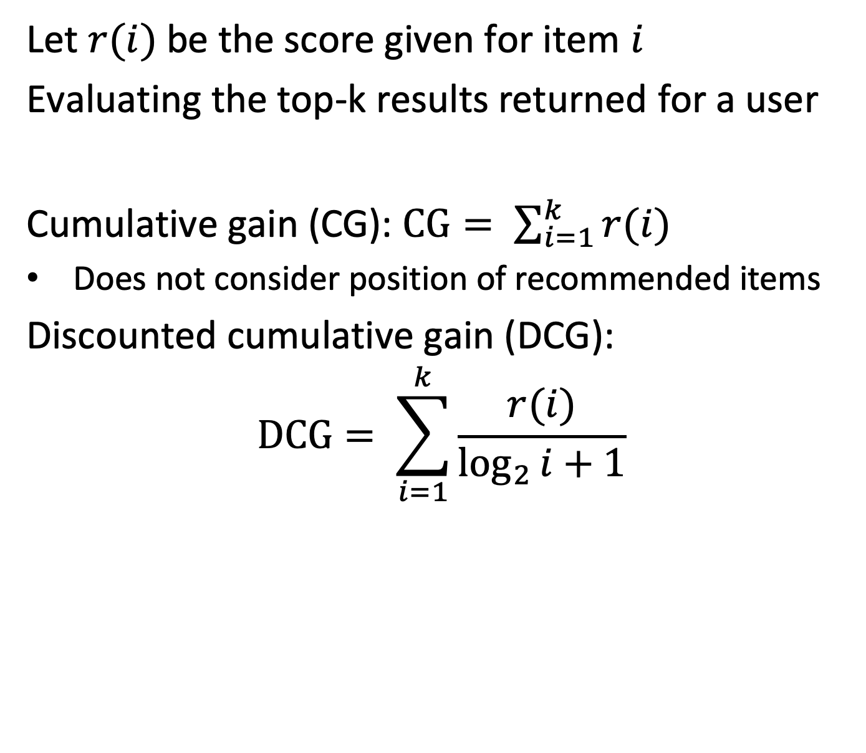
Evaluating Ranking Quality
Let $r(i)$ be the score given for item $i$
Evaluating the top-k results returned for a user
Cumulative gain (CG): $CG= \sum_{i=1}^{k}{r(i)}$
Does not consider position of recommended items
Discounted cumulative gain (DCG): $$DCG= \sum_{i=1}^{k}{\frac{r(i)}{\log_{2}{i+1}}}$$
Notes:
NDCG builds on cumulative gain (CG) and discounted cumulative gain (DCG).
With CG the scores of the top-k rated items are added up. In order to consider also the position, those scores are weighted with a position factor, such that with the same scores the ranking wins, that puts the higher scored items into higher positions.

Slide 49
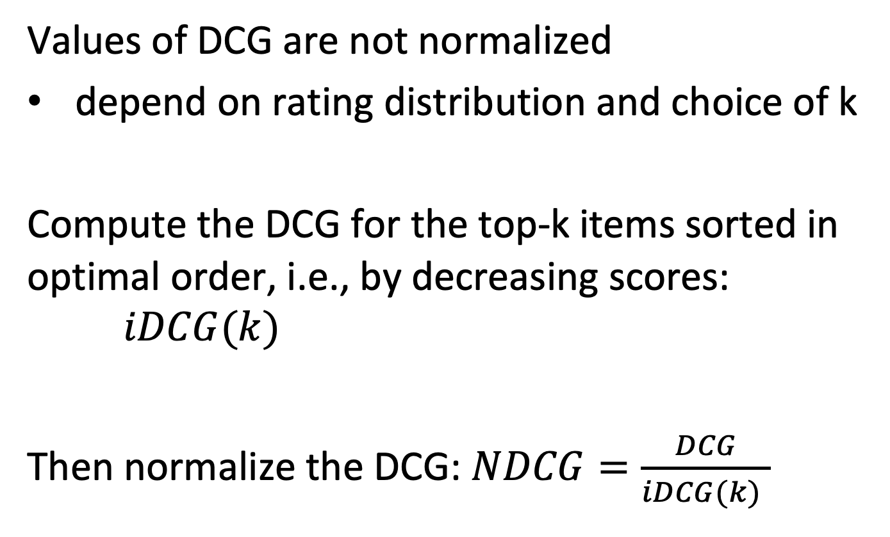
Normalized DCG (NDCG)
Values of DCG are not normalized
depend on rating distribution and choice of k
Compute the DCG for the top-k items sorted in optimal order, i.e., by decreasing scores: $iDCG(k)$
Then normalize the DCG: $NDCG=\frac{DCG}{iDCG(k) }$
Notes:
Finally, the metrics provided by DCG is not normalized and can thus not be compared with changing rating grades and choices of k. to compensate for that, the DCG for the optimally sorted items is considered as baseline. By normalizing the DCS using this baseline, one obtains the NDCG, as a standardized measure for ranking quality in the interval [0,1]

Slide 50
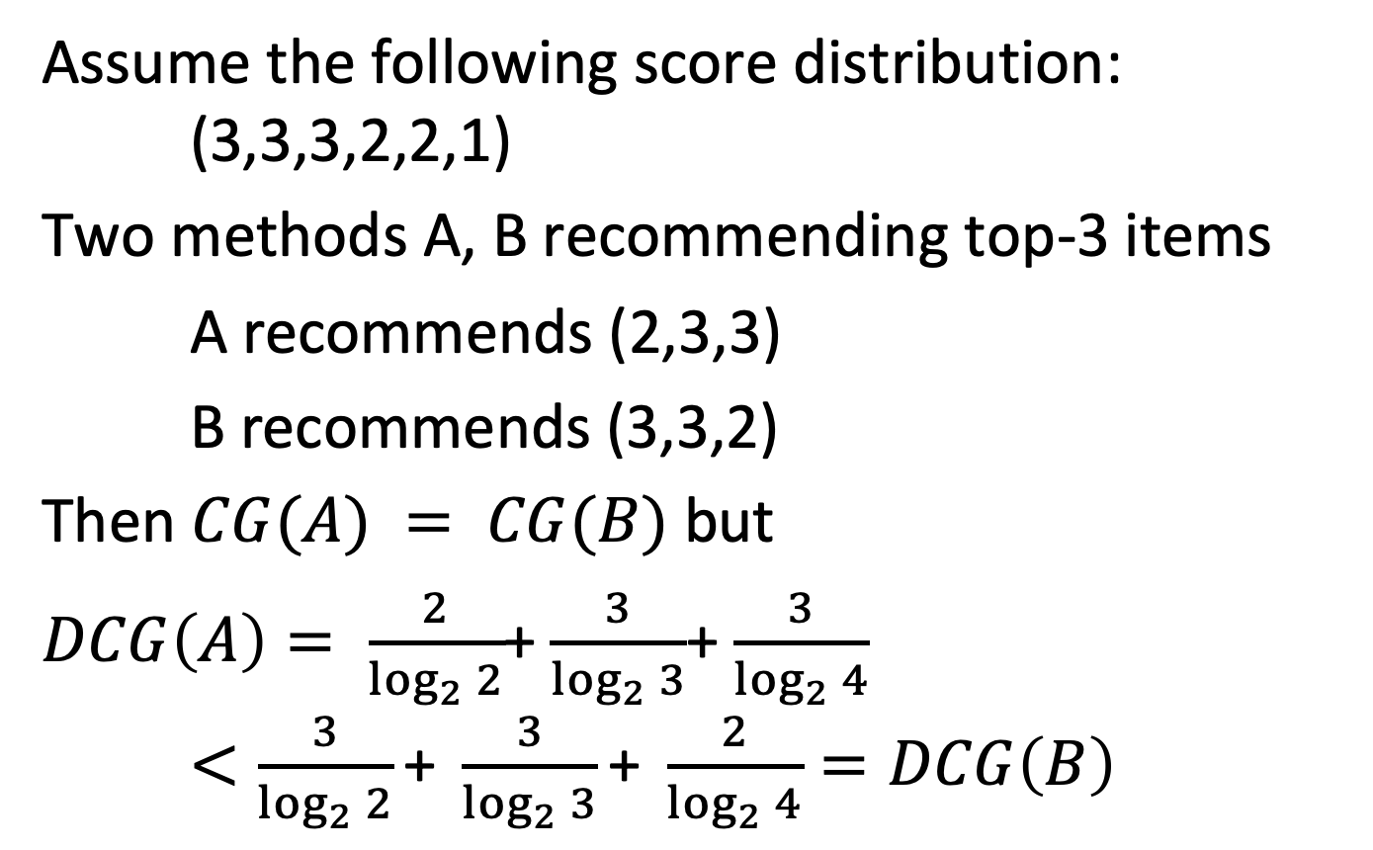
Example
Assume the following score distribution: (3,3,3,2,2,1)
Two methods A, B recommending top-3 items
A recommends (2,3,3)
B recommends (3,3,2)
Then $CG(A) = CG(B)$ but
$DCG\left(A\right)= \frac{2}{\log_{2}{2}}$+ $\frac{3}{\log_{2}{3}}$+ $\frac{3}{\log_{2}{4}}$ $<\frac{3}{\log_{2}{2}}\text{+} \frac{3}{\log_{2}{3}}\text{+} \frac{2}{\log_{2}{4}}=DCG\left(B\right)$
Notes:
The example illustrates the different steps in the calculation of NDCG.

Slide 51
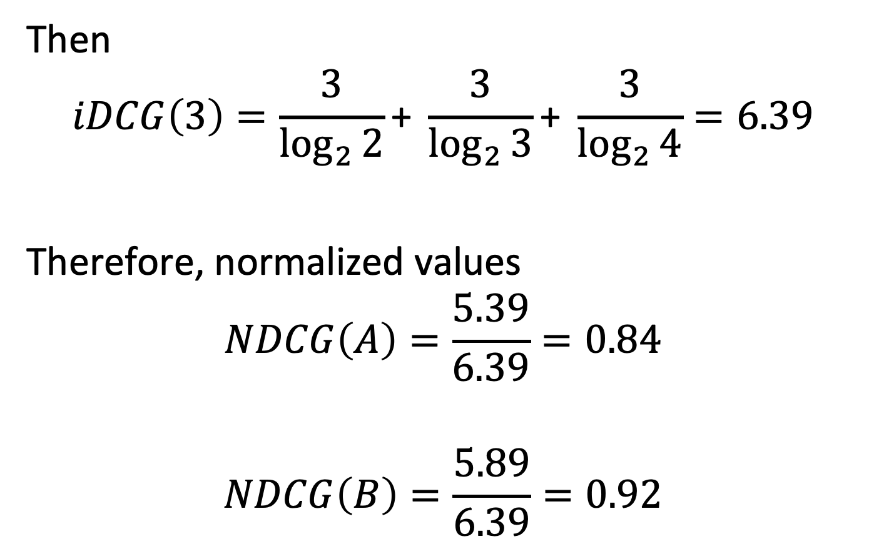
Example
Then
$$iDCG\left(3\right)=\frac{3}{\log_{2}{2}}\text{+} \frac{3}{\log_{2}{3}}\text{+} \frac{3}{\log_{2}{4}}=6.39$$
Therefore, normalized values
$$NDCG\left(A\right)=\frac{5.39}{6.39}=0.84$$
$$NDCG\left(B\right)=\frac{5.89}{6.39}=0.92$$

Slide 52
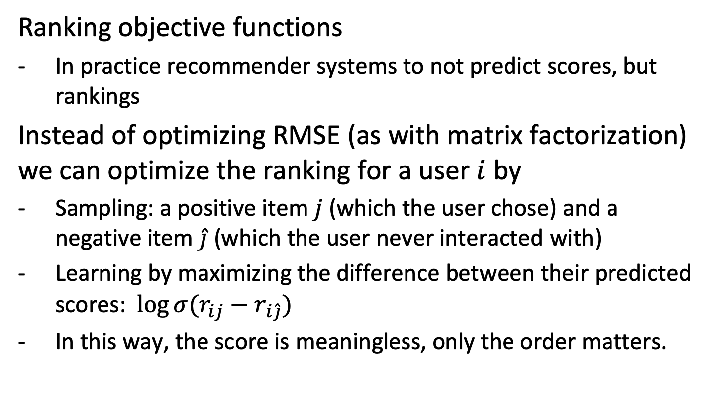
Outlook: Bayesian Personalized Ranking
Ranking objective functions
In practice recommender systems to not predict scores, but rankings
Instead of optimizing RMSE (as with matrix factorization) we can optimize the ranking for a user $i$ by
Sampling: a positive item $j$ (which the user chose) and a negative item $\hat{j}$ (which the user never interacted with)
Learning by maximizing the difference between their predicted scores: $\log{σ(r_{ij}}−r_{i\hat{j}})$
In this way, the score is meaningless, only the order matters.
Notes:
Finally, the absolute rating values are not essential for recommendation. What counts are the items being proposed. Therefore more recent approaches abandon RMSE as an optimization objective, and replace it with a metrics that essentially distinguishes only whether items are being selected by users or not.

Slide 53
Summary
Recommender Systems evolved, similarly as IR, from basic models, to models based on optimizing an objective function
Scaling to large numbers of users is a critical issue
Cold-start problem is not solved by the more advanced models

Slide 54
References
Chapter 9 in mmds.org
Recommender Systems Handbook, Springer 2015
Koren, Yehuda, Robert Bell, and Chris Volinsky. "Matrix factorization techniques for recommender systems." Computer 42.8 (2009): 30-37.
Ning, Xia, and George Karypis. "Slim: Sparse linear methods for top-n recommender systems." 2011 IEEE 11th International Conference on Data Mining. IEEE, 2011.
Rendle, Steffen, et al. "BPR: Bayesian personalized ranking from implicit feedback." Proceedings of the Twenty-Fifth Conference on Uncertainty in Artificial Intelligence. 2009.

